Slide 1
Examining Coastal Change in Levy County
Sean Reiss and Kevin Szatmary
University of Florida, Department of Urban and Regional Planning

Slide 2

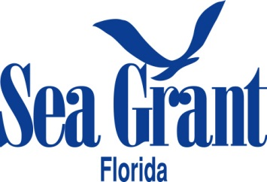
Why we’re here
Engaging the public on coastal change impacts
Discuss future sea level rise impacts and what that might mean for your organization
We want to hear from YOU

Slide 3
Agenda
Coastal change?
How has Levy County’s coast already changed?
Where we are today.
Concerns for the future.
What does this mean for me?

Slide 4
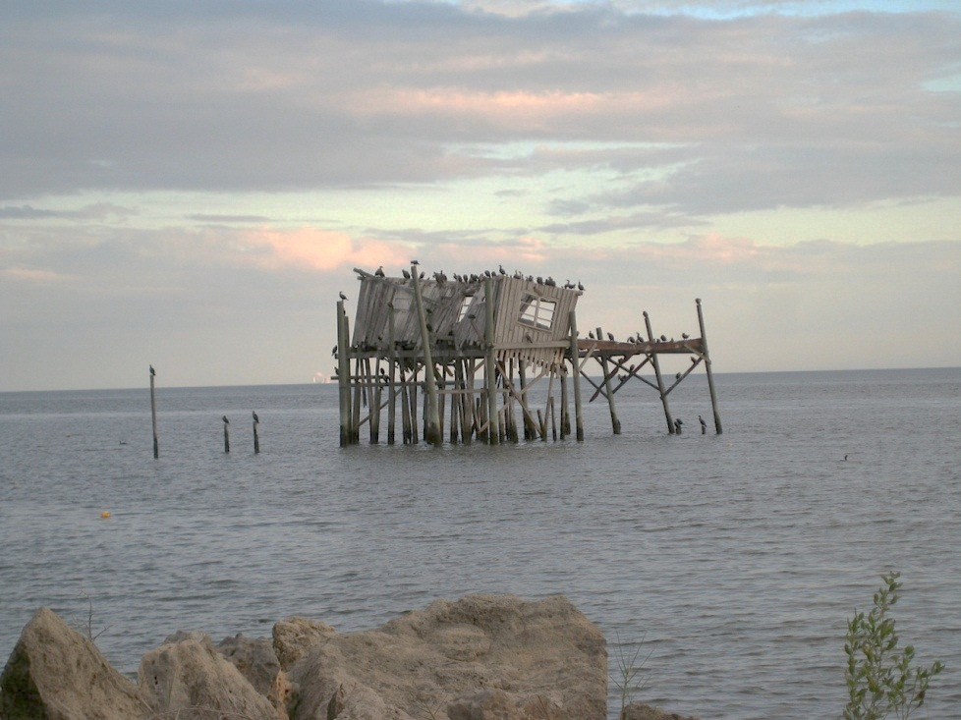
Changes to Consider
What is coastal change?
Sudden change
  Hurricanes
  Coastal flooding
Intermediate change
  Salt water intrusion
  Coastal erosion
Slow change
  Sea level rise

Slide 5
Sea level rise and changes to the coast
Coastlines are dynamic and always in a state of change
  Sea levels have been rising for the past 18,000 years
The coastline has been moving landward since the last glacial period as oceans have risen
  This shift has occurred at varying rates of speed
  There is reason to believe we are moving into a period of faster rates of rise in sea level
Notes:
-Average 6mm per year. Have seen periods of 40mm/yr in past 6000-8000yrs. 16mm/yr results in complete inundation of marshes->migration cant keep up with rate of rise

Slide 6
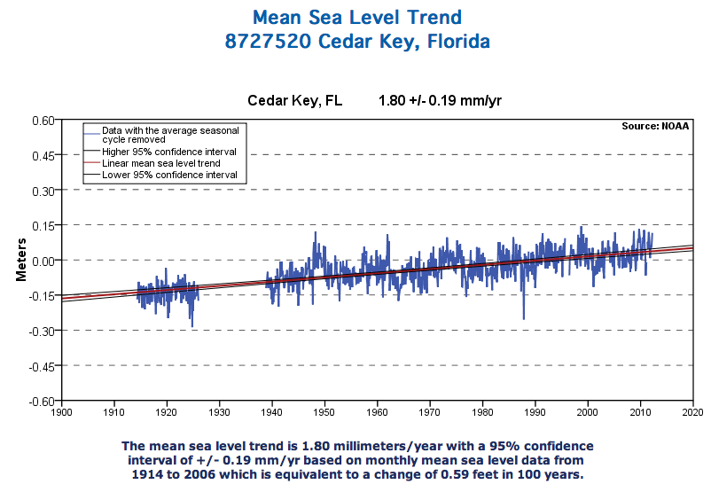
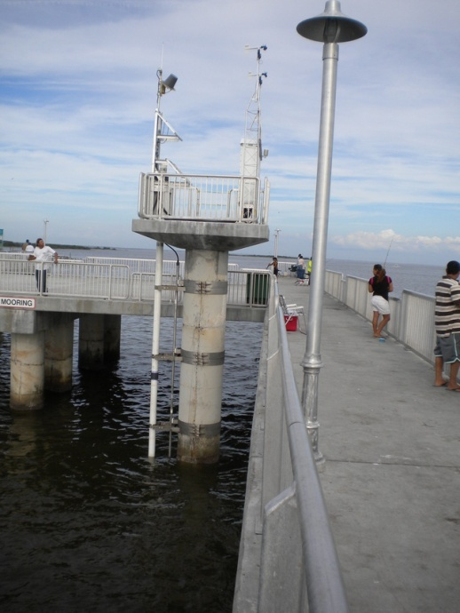
Tide Gauges and Trends

Slide 7
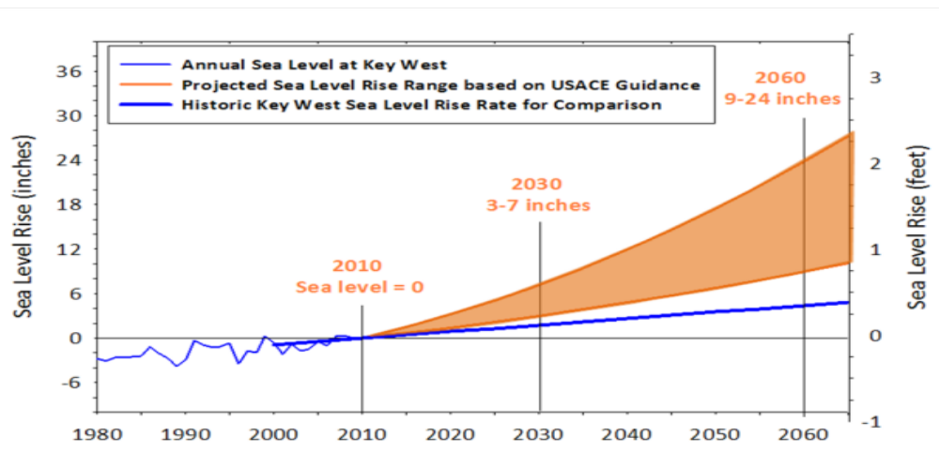
Sea Level Rise Projections
Southeast Florida Regional Climate Change Compact, 2011 - US Army Corps of Engineers

Slide 8
How has the coast changed in Levy County?
United States Geologic Survey (USGS) study looked at how the Big Bend coast has changed since the 19th century
  Used historic maps, nautical charts, and aerial images
Verdict: MARSHES ARE ON THE MOVE!!!
  Trend: Inland migration of marshes and loss of coastal forests

Slide 9
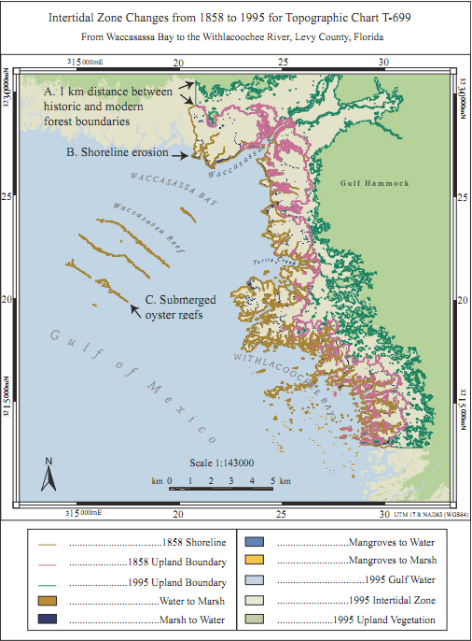

Slide 10
Where we are today
Changes to the coast
  Saltwater intrusion
  Changes in coastal habitat
  Coastal erosion
  Flooding
All of these are
intensified by sea
level rise

Slide 11
Economic concerns with future changes to the coast
We need to consider how current decisions will be affected by rising seas ➔ wise future investment
What does this mean for:
  Capital investments/improvements
    -Roads, real estate, buildings, future development, etc.
  Infrastructure and utilities
  Tourism
  Other industries

Slide 12
Conservation concerns
Coastlines are in a constant state of give and take
  Sediment deposition builds coastlines
  Coastal erosion takes coastline away, or moves it around (think coastal inlets)
Higher sea levels result in:
  Greater stresses on habitat – more salinity, increased flooding
  Alter the ecosystem ➔ coastal habitats migrate
    Coastline and saltwater marshes move inland, often displacing coastal forests
    Habitat needs space to migrate

Slide 13
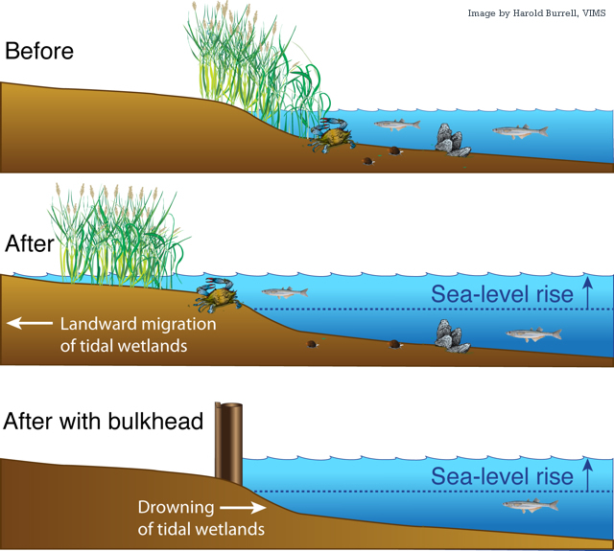

Slide 14
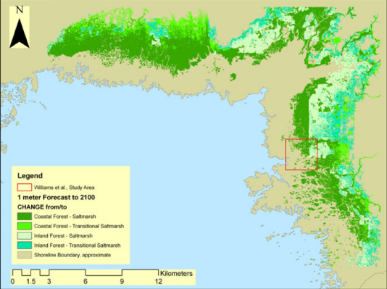
How will coastal habitats change in the future?
Researchers have examined the decline in coastal forests in Waccasassa Bay and the Withlacoochee Gulf Preserve
  Used field plot data and the Sea Level Affecting Marshes Model (SLAMM)
Right: SLAMM results depicting coastal forest transitioning to marsh with 1 meter of sea level rise

Slide 15
Coastal forests in retreat, now and into the future
Same story as the past, but more rapid
  Loss of coastal forests and gain of tidal flats and saltwater marsh
  Coastal hammock and forest decline:
    Chronic long term stresses resulting from higher sea levels
    Periodic disturbances from intense storm and drought events
  Increasing presence of mangroves in Levy County

Slide 16
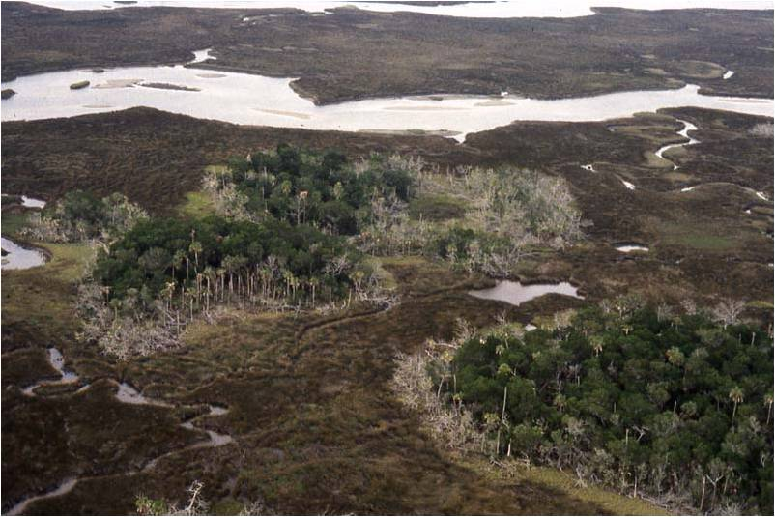
Declining coastal hammock in the Withlacoochee Gulf Preserve
Photo Credit: Jack Putz

Slide 17
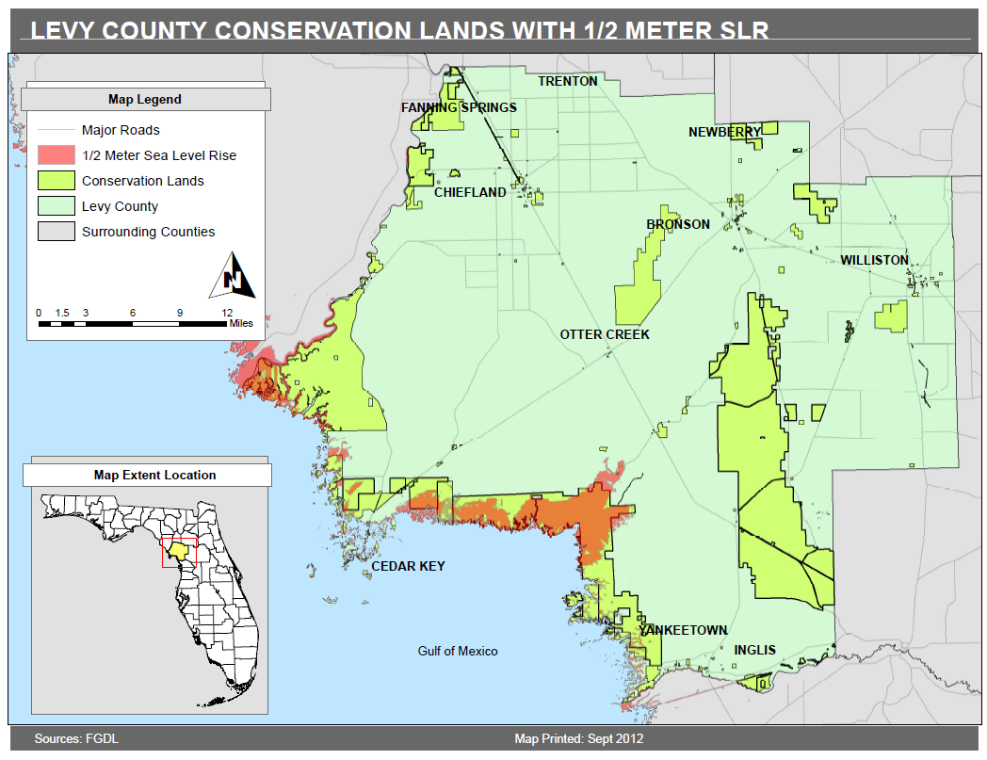
What does this mean for me?
We may lose existing conservation lands to permanent flooding
Notes:
Things will look different in the future
More open water
More saltwater marsh
Less coastal forests and hammocks

Slide 19
What does this mean for me?
Migrating coastal habitats and human development may be competing for the same land
We need to take into account future sea level rise in conservation land planning and management decisions

Slide 20
What does this mean for me?
  We need to plan ahead so we can:
    Avoid land use conflicts
    Better prioritize land allocation and future conservation efforts
    Maintain critical ecological corridors and adapt them to future sea level rise
    Make informed decisions on capital investments/improvements

Slide 21
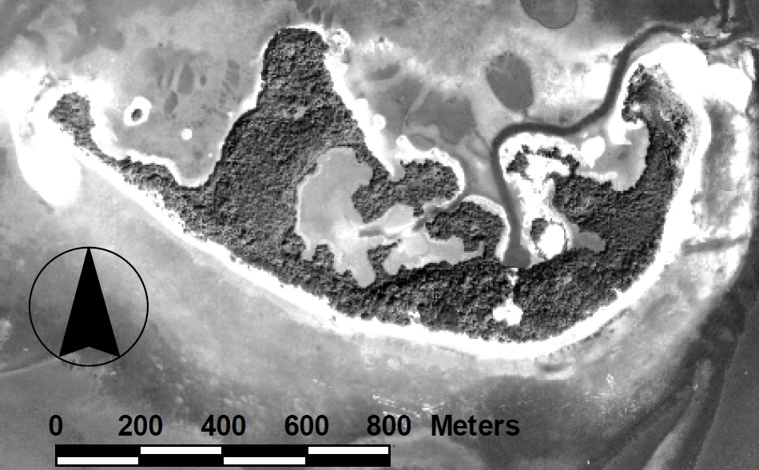
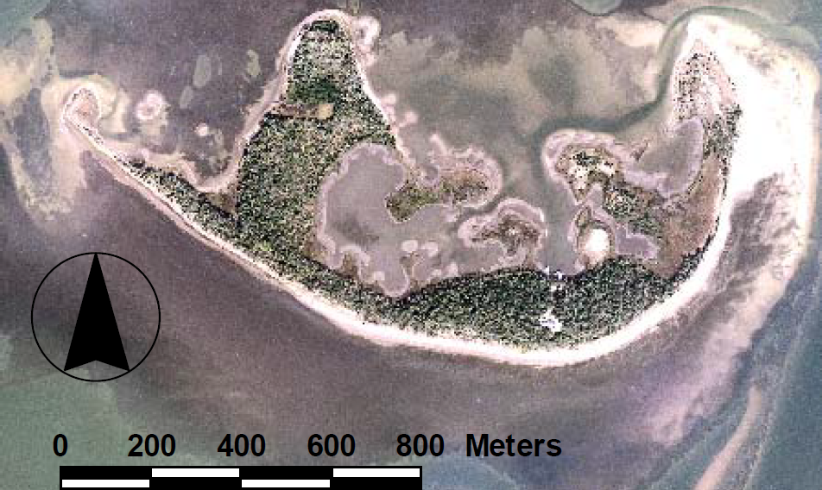
DISCUSSION
Have you noticed any changes along the coast?
What’s important to you?
What additional information would be helpful?
What sea level rise scenario would you be comfortable planning for?
Seahorse Key
1961
2001

Slide 22
Thank you!
For more information please contact:
  Gail Easley at easleyg@ufl.edu
Visit our website and check on project updates and scheduled public meetings:
      http://ChangingLevyCoast.org
Visit us at the 43rd Annual Cedar Key Seafood Festival

