Slide 1

FEMA’s Methodology for Estimating Potential Losses from Disasters
Kevin Szatmary
URP 6341
Sept 6, 2012

Slide 2
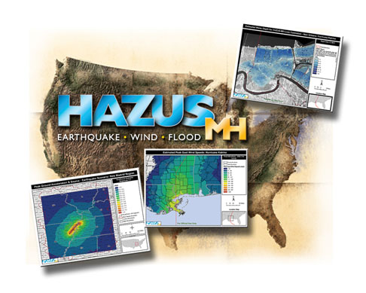
What is Hazus-MH?
Hazards-United States / Multi-Hazard
Estimates potential losses from earthquakes, floods, and wind/hurricanes
Requires ArcGIS 10+ and Spatial Analyst

Slide 3









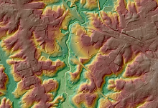
Methodology
5. Estimate losses/needs
4. Estimate damage
3. Overlay inventory
2. Define hazard
1. Define geographic area

Slide 4
Applications
Allows users to estimate losses with or without sea level rise
Allows users to customize hurricane tracks and levels of damage (wind and storm surge)
Can be used with property appraiser’s data to estimate types and values of losses

Slide 5
Data Requirements
Inventory of assets
  Buildings
  Infrastructure
  Population/demographics
Users may use property appraiser’s data and U.S. Census data

Slide 6
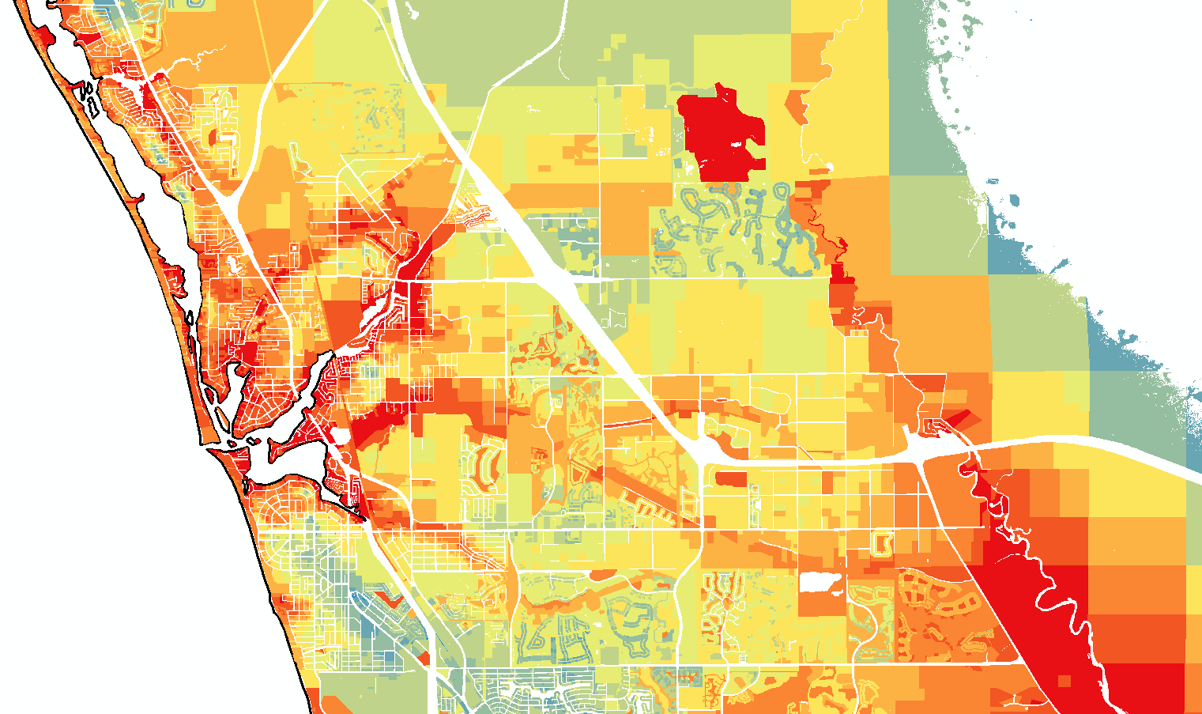
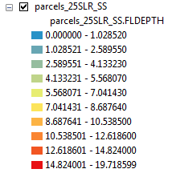
Sarasota County – 2.5m SLR + Cat5

Slide 7
Hazus Benefits
Identify vulnerable areas
Assess level of readiness before a disaster occurs
Estimate potential losses

Slide 8
References
Hazus-MH can be ordered for free from www.fema.gov/HAZUS
Mazus-MH: Know Your Risk (http://www.fema.gov/library/viewRecord.do?id=3299)
HAZUS.org Hazus Resource (http://www.hazus.org)
FEMA: Protecting Our Communities (http://www.fema.gov/protecting-our-communities/hazus)

