Slide 1
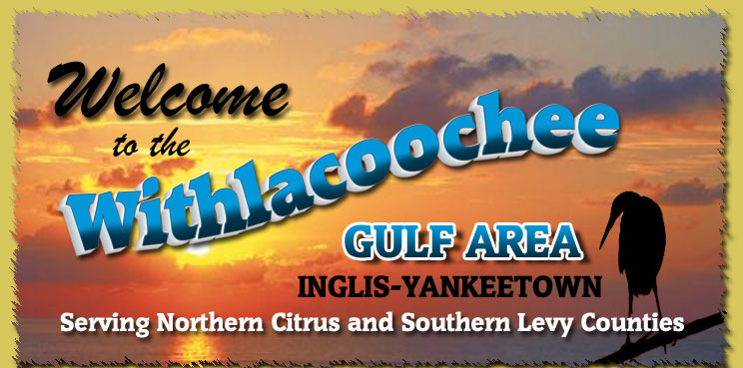
Coastal Change in Levy County
Doug McDuffie & Stephanie Zarkis
Notes:
DOUG
Hello, everyone. My name is Doug McDuffie (and I’m Stephanie Zarkis) and we are here today to talk about past, present and future changes to Florida’s coastline. Florida’s coast is the reason why many of us are here. People come here to fish, swim, engage in business, and admire the beauty of the area. The coast has changed in the past and will continue to change into the future.

Slide 2
Why We’re Here
Engaging public on coastal change impacts
Impact of future sea level rise
  Economic – industry and tourism
  Infrastructure – water and sewer
  Environmental – habitat loss and erosion
We want to hear from you
Notes:
DOUG
Changes to the coast may have serious effects on Florida’s treasured lifestyle and many may be asking, “what does this mean to me?” Well, we are here to discuss that, as part of a Florida Sea Grant and University Florida project on planning for coastal change in Levy County.
The issues we would like to address deal with industry, infrastructure and environmental concerns
We also really want to know what you think about these and other issues

Slide 3
Changes to Consider
What is coastal change?
  Sudden changes
    Hurricanes and floods
  Intermediate change
    Salt water intrusion and erosion
  Slow change
    Sea level rise
Notes:
DOUG
Before we begin, it is important to identify just what kind of changes we plan to talk about.
Changes to Floridas coastline have sometimes occurred quickly while other times it occurs more slowly.
The slow changes can be seen in coastal erosion, habitat loss, and the emerging presence of non-native plants and animals. Rapid coastal changes usually take the form of hurricanes and other large storms.
Other changes to the coast have been well publicized lately, for example, with news reports discussing sea level rise and saltwater intrusion in drinking water wells.

Slide 4
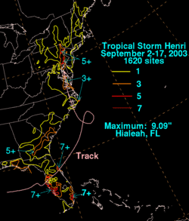
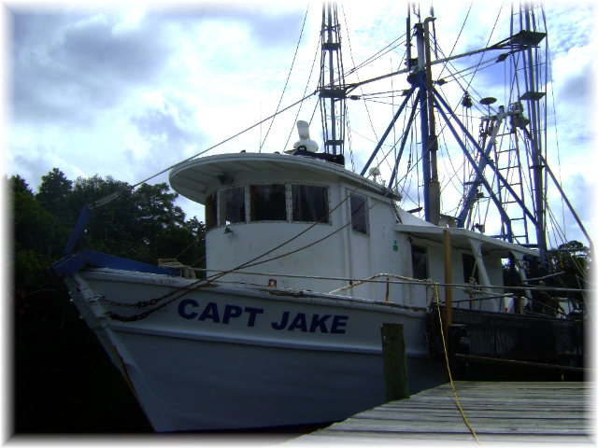
Agenda
Past trends
Present issues
Future projections
Discussion
Notes:
DOUG
The general outline and purpose of our presentation is to:
present information regarding changes to the coast,
2) gather public input and feedback, and
3) discuss issues pertinent to the longterm economic health of Cedar Key.
By identifying, discussing and ultimately planning for sea level rise in Cedar Key, prudent and cost-efficient solutions can be identified and implemented over time. Topics to be discussed include: how the coast is changing; how changes in the coast might affect you; and what that might mean for you.

Slide 5
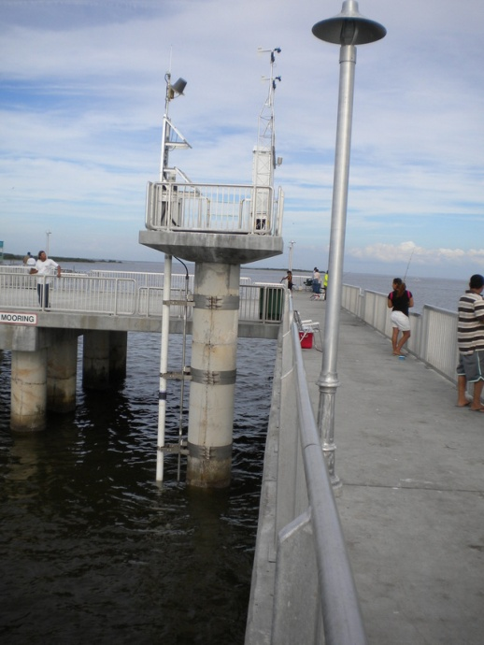
Tide Gauges and Trends
Notes:
steph

Slide 6
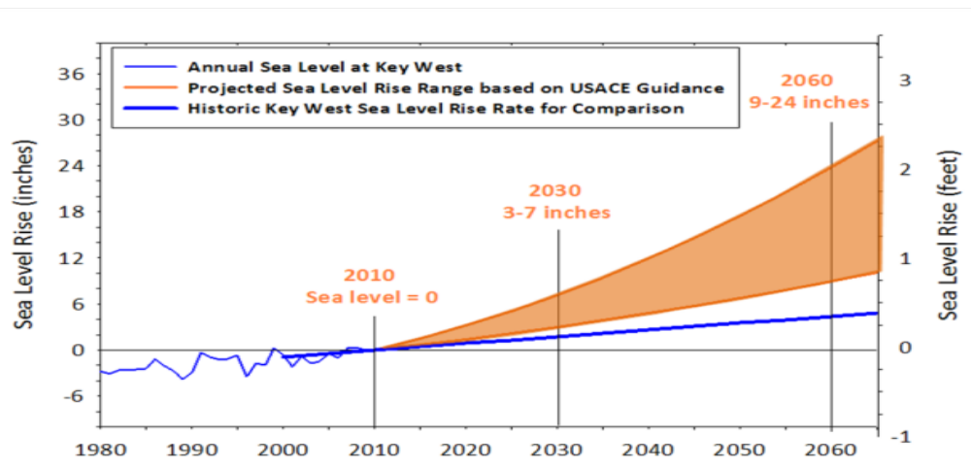
Sea Level Rise Projections
Southeast Florida Regional Climate Change Compact, 2011
US Army Corps of Engineers
Notes:
Steph
Cone of uncertainty

Slide 7
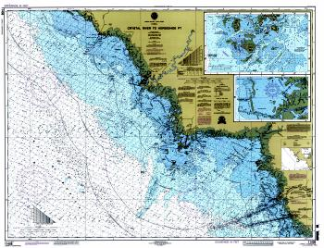
Where We are Today
Sea level rise
Coastal change
    Saltwater intrusion
    Habitat loss
    Erosion / flooding
Notes:
DOUG
Of significant importance to Cedar Key and certainly to you, the Chamber of Commerce, are changes to local economic conditions. Cedar Key has experienced many economic shifts over the years. Notable ones include the relocation of the community after the storm of 1896, the gill-net ban, and the upgrading of the Cedar Key well.
Sea level rise makes coastal changes more pronounced
While not seemingly related, these events raise the larger point that transitions, sudden or slow, are part of living here in Cedar Key. We can learn from the changes in the past to make better decisions for the future.
The implications of physical changes to the coast include issues like saltwater intrusion into local wells, the loss off local wildlife habitat, and other issues like erosion and inundation caused by sea level rise.

Slide 8
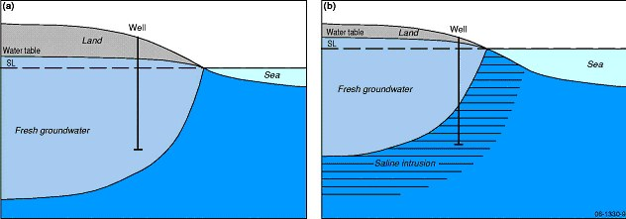
Salt Water Intrusion
Notes:
DOUG
Illustrated here is the process of Salt water intrusion. When wells are placed near to the coast, as they are in Cedar Key, the potential for salt water intrusion increases. The reasons they do so may be related to drought conditions, large uptakes in water, or others.
As the sea level rises, the balance of fresh and salt water is shifted in favor of the salt water, allowing it to filter into the fresh water system.
Sho
When sea level rises it displaces rfres water wn in figures A and progressing to B highlights the impact that sea level rise can have on local wells

Slide 9
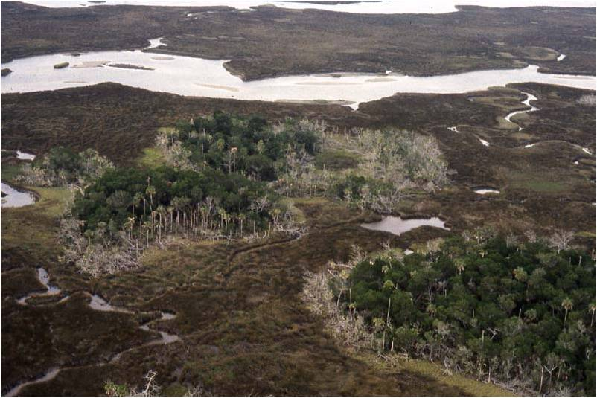
Waccasassa Bay
Notes:
DOUG
Seen here is an image of nearby Waccasassa Bay. While this image may seem pleasant, there is cause for concern.
Similar to the previous slides depiction of salt water intrusion, rising sea levels are making life tough for coastal forests known as coastal hammocks, because salt water is drying up the roots of the trees. These hammocks are important parts of Cedar Key and the nature coasts natural environment. Without them, many plants and animals would not have a home.
Now, it is important to understand that the changes in the environment are a natural process. The migration or transition from one type of land to another has occurred many times before. Inland forests become coastal hammock, coastal hammocks become marshland, and marshland eventually sinks into the sea. However, the concern for these ‘migrating’ or moving environments is made worse by Sea level as it forces the change of coastal land much faster – so fast in fact that many of the coastal hammocks can’t keep pace and end up dying.

Slide 10
Erosion and Flooding
Erosion plays an important role in shaping the coastal environment
  Usually noticeable after large storms
Flooding is more common as sewers flood easier and water collects in more areas
Sea level rise worsens erosion and flooding
Notes:
Steph: Lets get a new, smaller picture

Slide 11
Future
What are the regional impacts of sea level rise?
What does this mean for Yankeetown and Inglis?
Notes:
Steph: Lets get a new, smaller picture

Slide 12
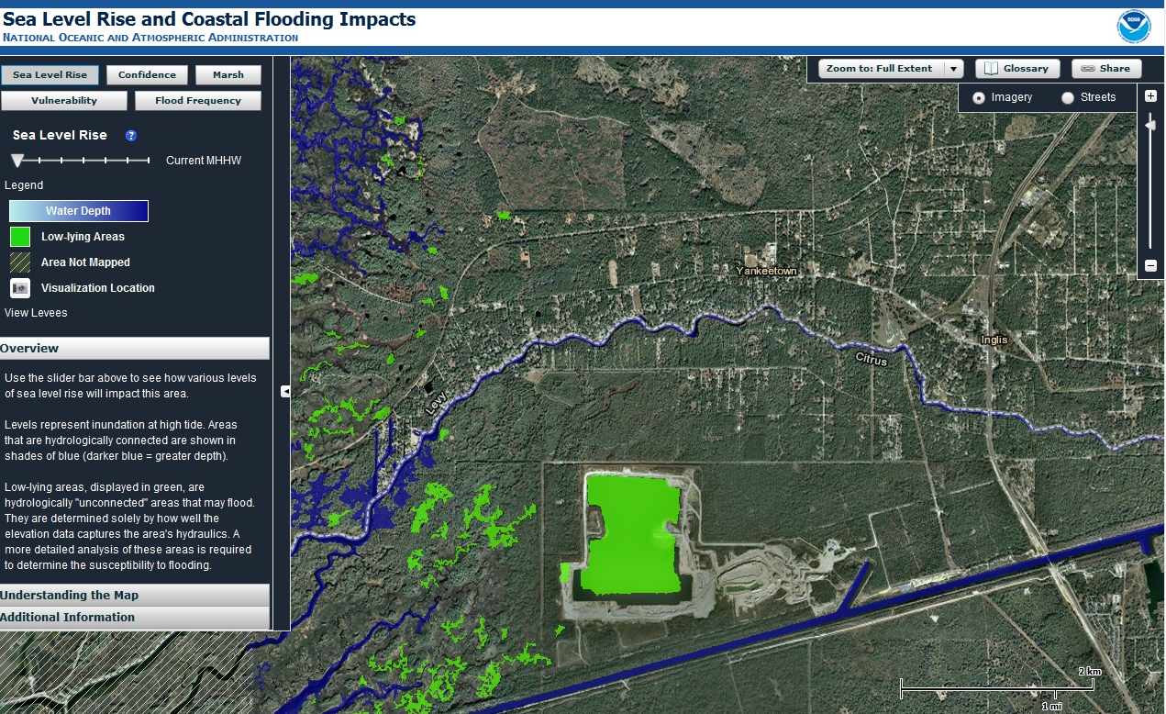
Today
NOAA Sea Level Rise Viewer http://www.csc.noaa.gov/slr/viewer/#
Notes:
steph

Slide 13
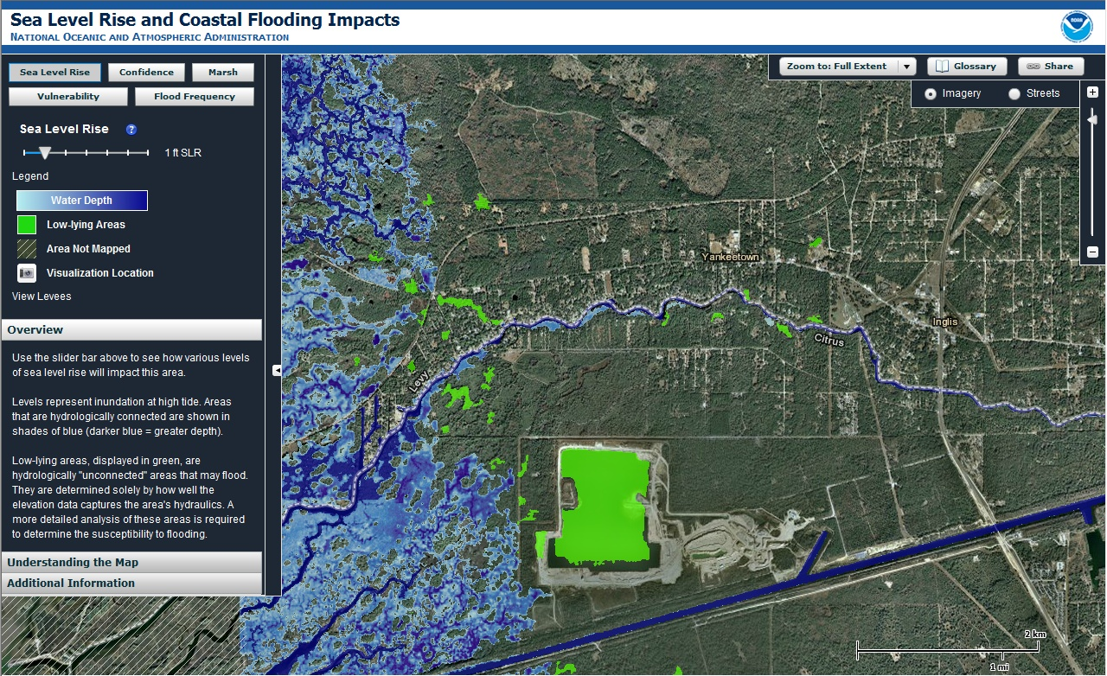
Future
With 1 foot sea level rise
Notes:
steph

Slide 14
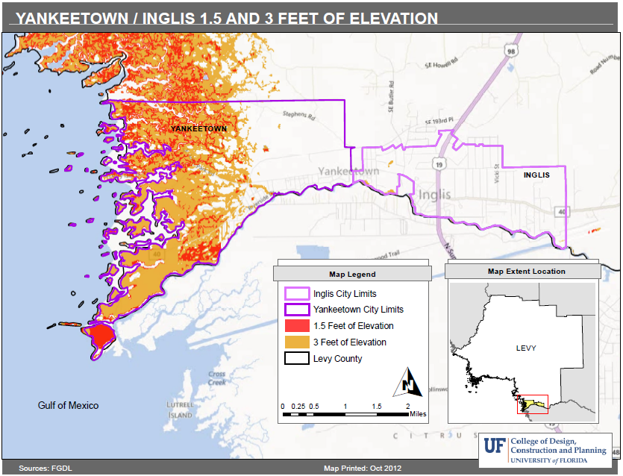
Notes:
DEM Note that this map (1) indicates elevation, rather than sea level rise, since elevation is a reflection of sea level rise vulnerability - regular flooding at these elevations is possibly within the next 60 years; it is elevation not sea level rise and that using elevation allows the observer to see areas that are vulnerable.

Slide 15
Economic Concerns
What does this mean for:
  Capital investments / improvements
    Roads, land and buildings
  Infrastructure and utilities
    Water
    Sewer
    Electric
  Other industries
Notes:
DOUG
Decision-making… water system is new → future replacement water system needs to consider the effects of SLR
Before we conclude, we should take time to think about how the economy in Cedar Key may be affected. The consequences of sea level rise on our natural and built environments, and what that means to Cedar Key, is a key concern.
Capital investments like roads, land and buildings might be affected by sea level rise and planning for their future location, upgrade or otherwise is of interest to the community.
Next, consideration ought to be given to the issue of utilities. If needed, where will the next well be located? How will Cedar Key handle its future plumbing and sewer needs? Is the electricity supply in jeopardy? What is likely to happen to the tourism industry? These and other questions regarding the critical infrastructure of Cedar Key might be considered as we plan for sea level rise

Slide 16
Conclusion
Coastal change…
  Short term – powerful storms and economic shifts
  Midterm – habitat loss, saltwater intrusion
  Long term – rising sea levels
Planning for future change may cut costs and allow for proactive decision-making
Notes:
DOUG
In conclusion, we can see that changes in the Florida coastline present many challenges for coastal communities like Cedar Key.
Some of these changes, like hurricanes and laws, are sudden and potentially disastrous. These are the kinds of changes that almost nothing can be done to prevent.
Other changes take years but, over the course of a life, are made evident like the loss of coastal hammocks or forests and the intrusion of saltwater into fresh water wells. These changes require action and are usually dealt with accord
The threat of sea level rise to Cedar Key is similar to these gradual changes but much slower. It will likely change many aspects of our communities, the state and even the nation, though in our lives we may not notice it.
By understanding where we are vulnerable and planning for longterm solutions, we can minimize the effects of coastal change, and better preserve the communities and environments we love.

Slide 17
Discussion
What’s important to you?
What additional information would be helpful?
What changes do you expect in the economy, infrastructure and environment of Yankeetown and Inglis?
If you were going to plan for sea level rise, what scenario would you consider?
Notes:
steph

Slide 18
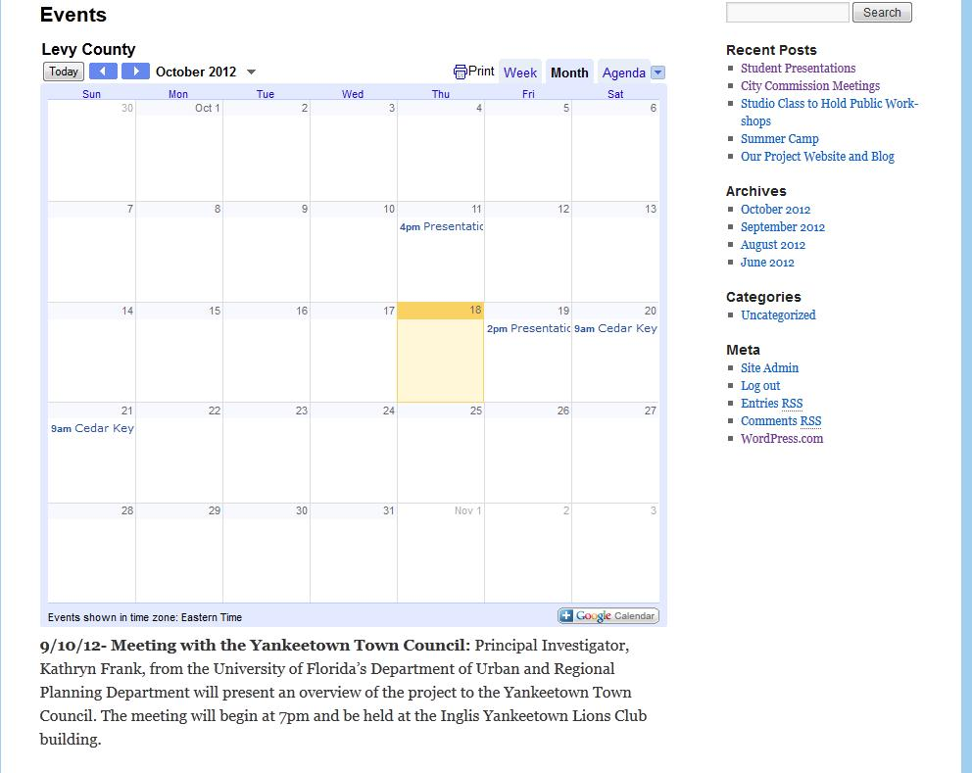
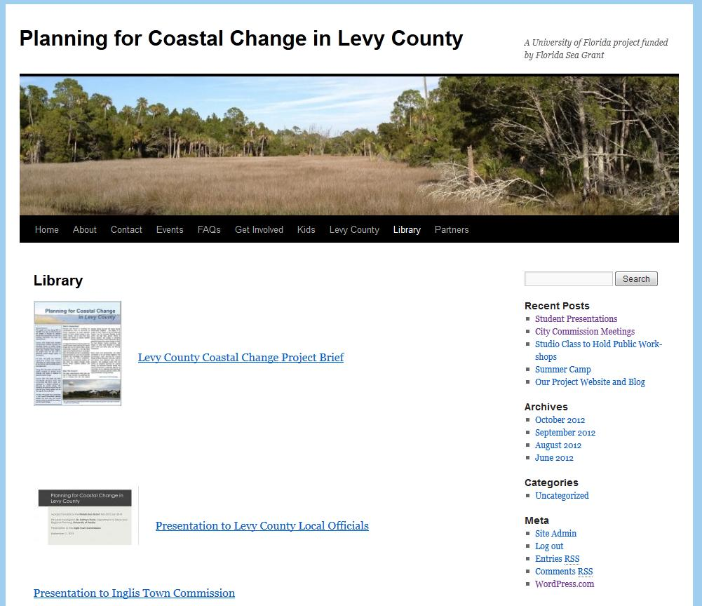
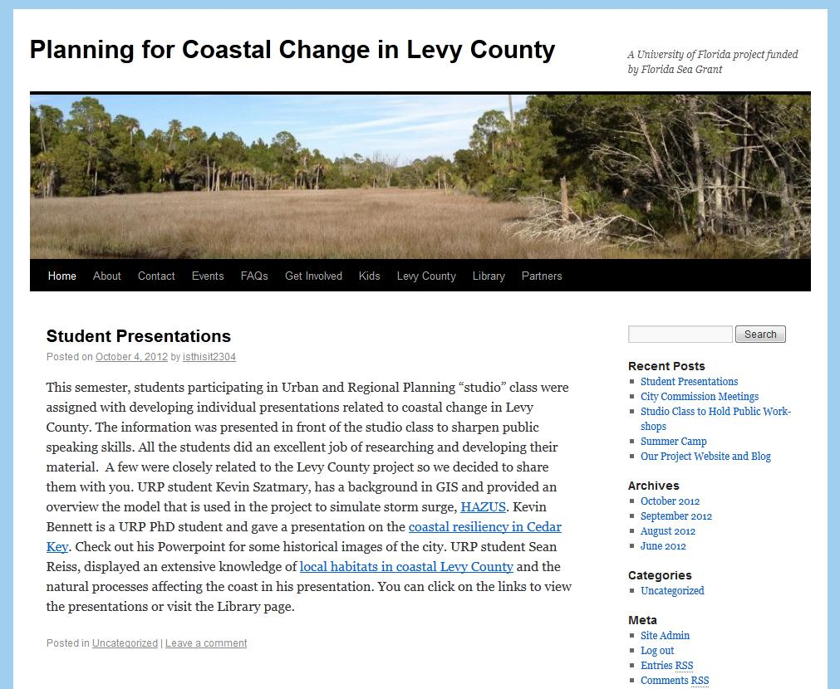
Website: ChangingLevyCoast.org

Slide 19
Thank you!
For more information please contact:
  Gail Easley at easleyg@ufl.edu
Visit our website and check on project updates and scheduled public meetings:
      http://ChangingLevyCoast.org

