Slide 1
Adaptive Strategies Workshop 2
Planning for Coastal Change in Levy County
August 15, 2013
Yankeetown-Inglis

Slide 2
Welcome and Workshop Goals
Dr. Kathryn Frank, Principal Investigator
Michael Volk, Project Manager
Graduate Assistants
  Rong Zeng
  Sean Reiss
  Jana Rosenbloom
  Kevin Bennett
  Zach Wignall
Goals: Collaboration
  Provide you with specific information about coastal change issues in the Yankeetown-Inglis area
  Receive your input of local knowledge, priorities, and ideas for adaptive strategies
  Present and receive feedback on our adaptive design recommendations

Slide 3
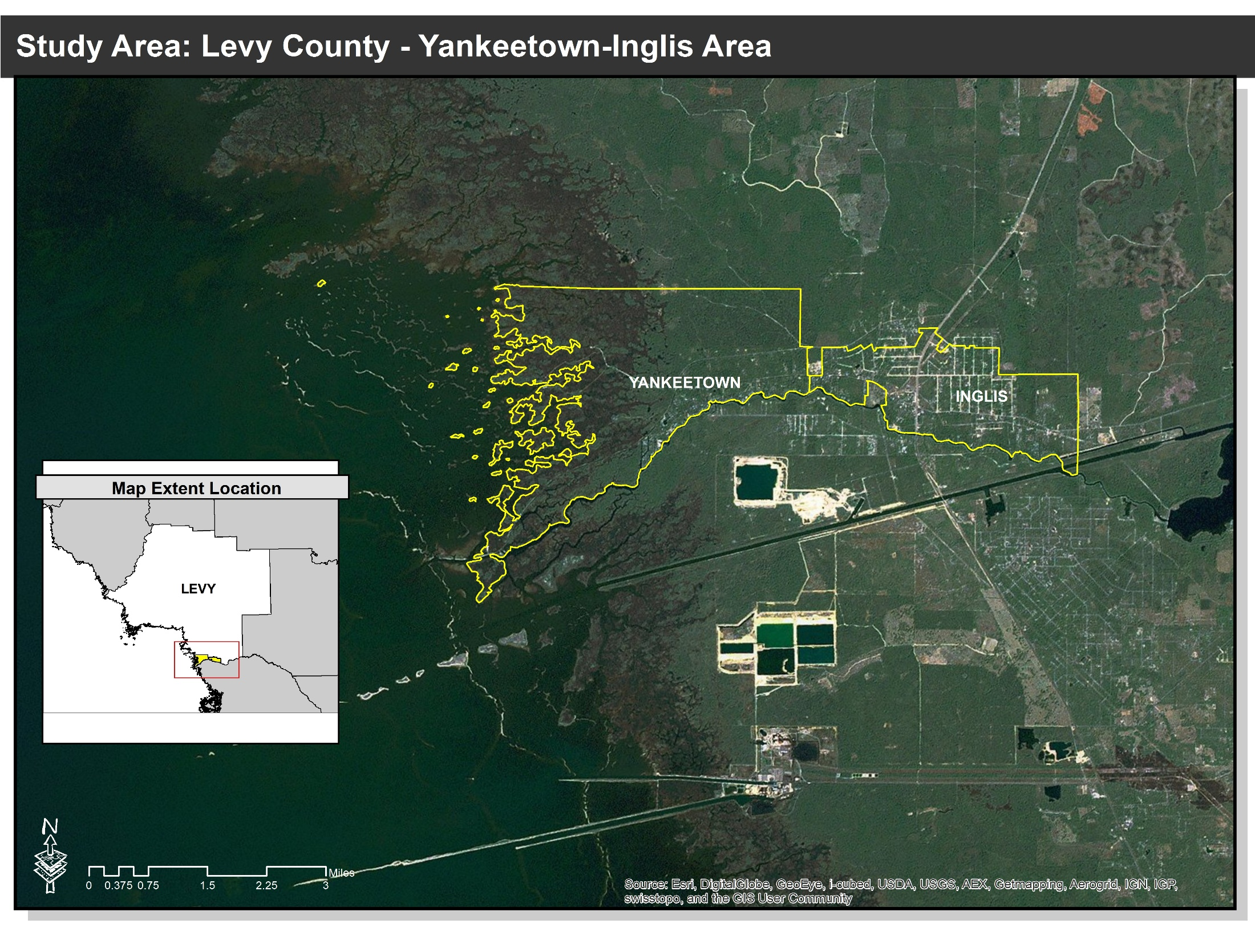
Study Area
Larger study area
Focused study area – Yankeetown-Inglis

Slide 4
Workshop Agenda
Project Update and Coastal Change Background
Coastal Change Oral History Video
Break
Adaptive Strategy Recommendations
Break
Participant Closing Remarks and Next Steps

Slide 5
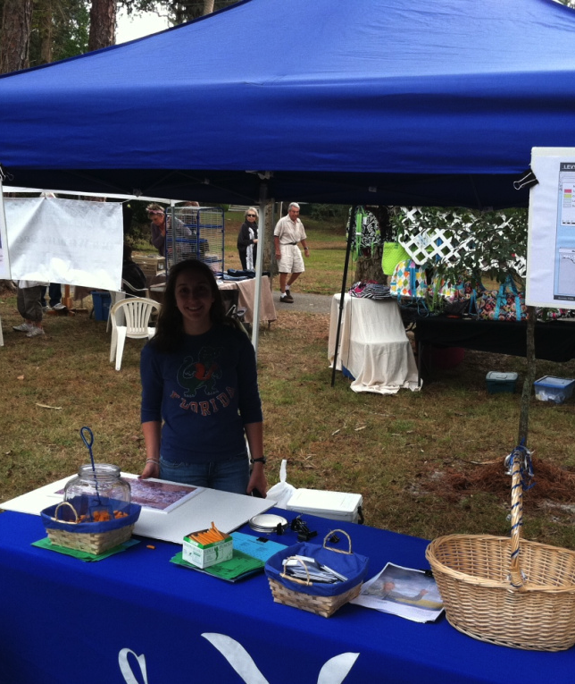
Project Update
Activity | Time
Research | Ongoing
Cedar Key Summer Youth Program | Summer 2012
Levy County outreach | Fall 2012
Cedar Key-Rosewood adaptive strategies | Spring 2013
Coastal change oral histories | Spring 2013
Yankeetown-Inglis adaptive strategies | Summer 2013
Arts exhibit and project wrap-up/reports | Fall 2013

Slide 6
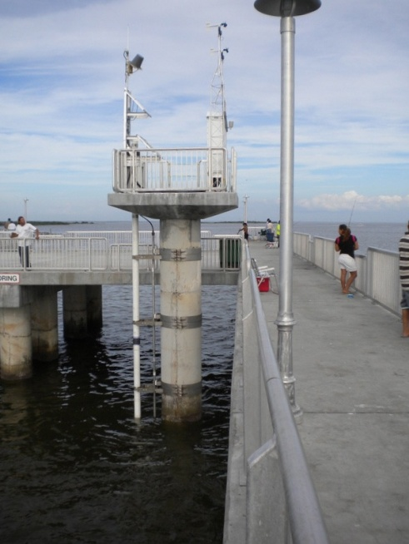
Past Sea Level Rise in Levy County
8 inches

Slide 7
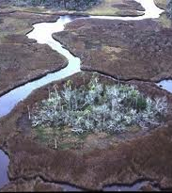
Coastal Change and Impacts of Sea Level Rise
Habitat and species changes
More frequent flooding at high tide
Erosion and corrosion of infrastructure
Release of pollutants
Saltwater intrusion into aquifers
Storm surges farther inland

Slide 8
Sea Level Rise Projections for Levy County
US Army Corps of Engineers Guidance
1.5 to 5 feet
Projected Sea Level Rise Range
Historic Cedar Key Sea Level Rise Rate for Comparison
(8 inches per 100 years)
5
4
3
3 feet
Sea Level Rise in Feet
0.5 to 1.5 feet
2
1
2010
2050
2100

Slide 9
Sea Level Affecting Marshes Model (SLAMM)
Video

Slide 10
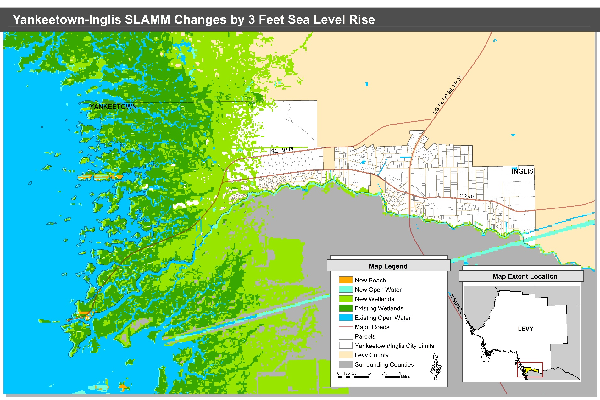
Areas Likely to Change by Year 2100
Data source: The Nature Conservancy
Notes:
To be updated

Slide 11
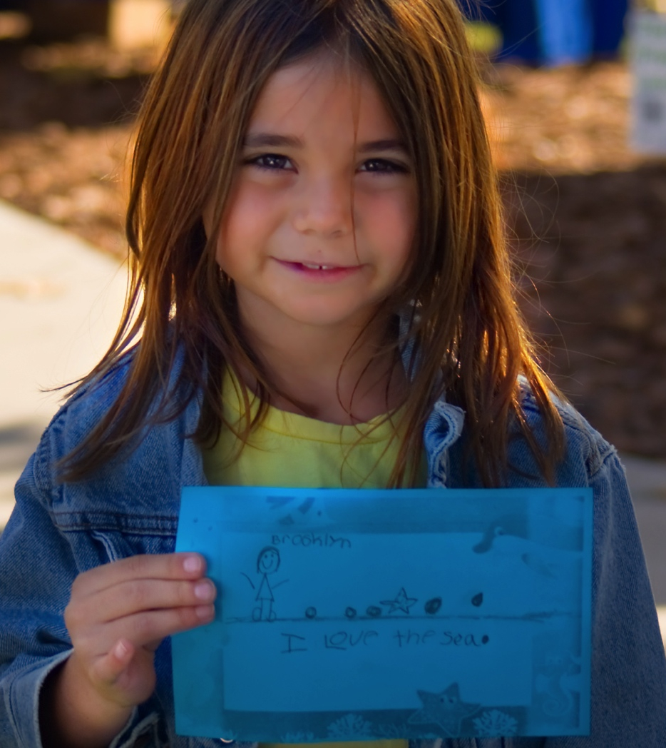
Why We’re Here
Coastal change is happening now and will accelerate.
Planning is slow, so need to start now.
Responsible and responsive leadership.
Opportunities to reduce costs, explore new markets, and plan better overall.

Slide 12
Coastal Change Oral History Video

Slide 13
Adaptive Strategy Recommendations

Slide 14
Yankeetown-Inglis Design Approach
Inventory of social, economic, and geographic data
Visits to study area and visual analysis
Public workshop and SWOT analysis
Design goals and objectives
Team analysis and recommendations
  Spatial and built environment
  Water and wastewater infrastructure
Final report

Slide 15
Public Input Workshop 1
SWOT analysis
Adaptive strategies game
Increasing notice and concern for coastal changes
  Saltwater intrusion and water supply
  Conservation and ecosystem restoration
  Long-term planning for coastal change while maintaining rural community character
  Incorporate policy change to address sea level rise issues
  Need support and help from the State of Florida

Slide 16
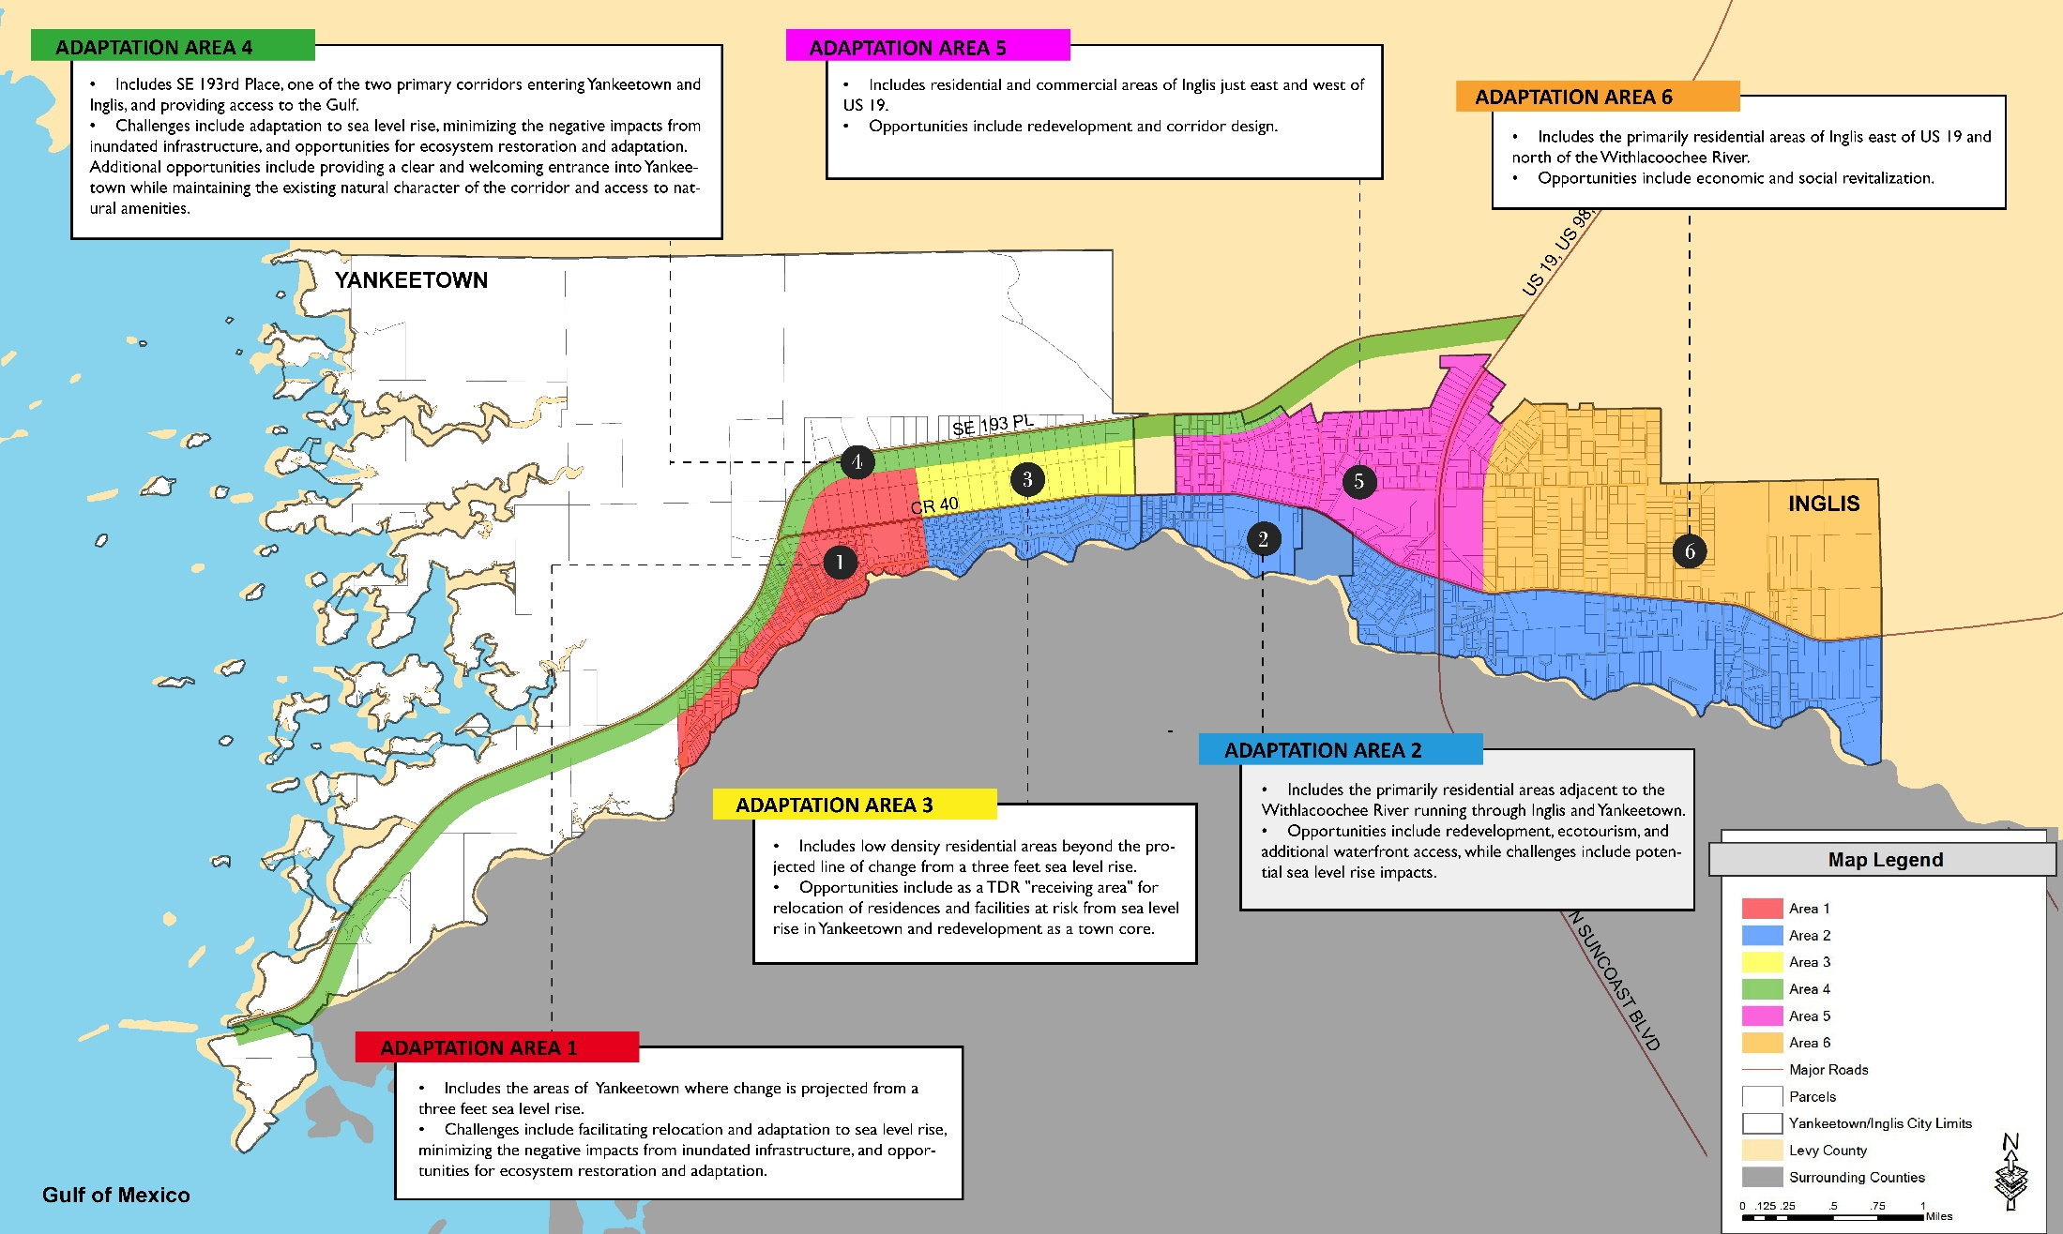
Community Resource Adaptation Action Areas
Notes:
Describe here the overall two pronged approach-
Phased relocation- starting with moderate revision of existing TDR areas
Careful redevelopment and economic stimulus
Map to be updated

Slide 17
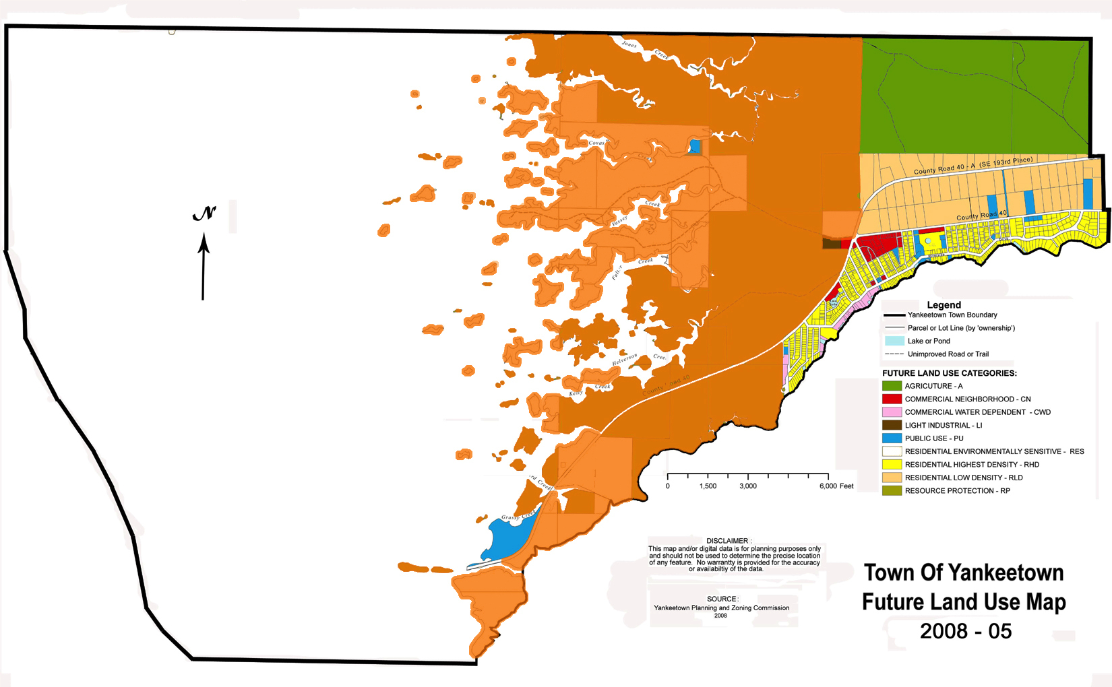
Natural Resource Adaptation Action Area
Proposed Natural Resource AAA
Notes:
Coordinate the goals, objectives, and policies in the Natural Areas AAA to areas in the Community Resource AAA, and coordinate policies between the two.
Various objectives from the NRAAA relate including
Inventory objectives (such as 1.3.0- Habitat and Species, Structure and Infrastructure, and Repetitive Loss Inventory and Ranking)
Goal 3.0- Structural Adaptation
Objective 4.2- Freshwater flow
Goal 5.0- Citizen education
-Objective 6.1- Intergovernmental coordination

Slide 18
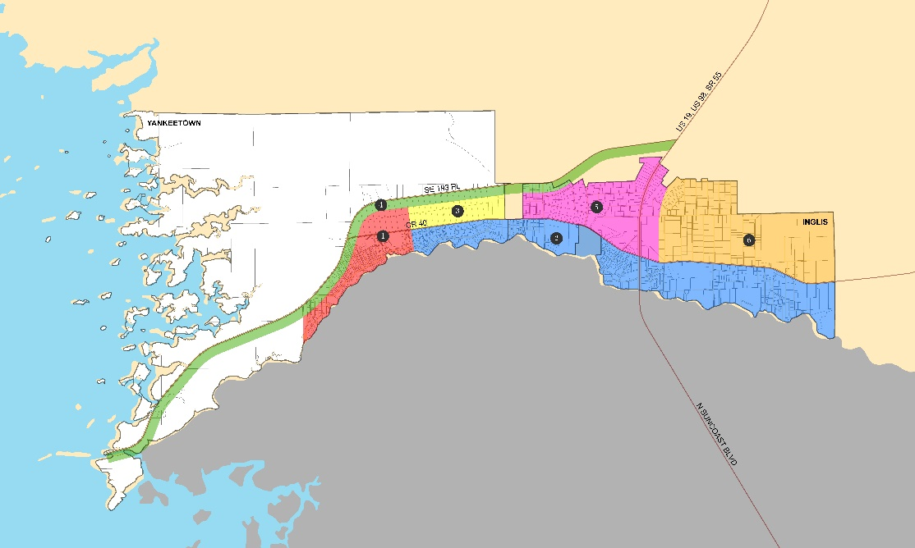
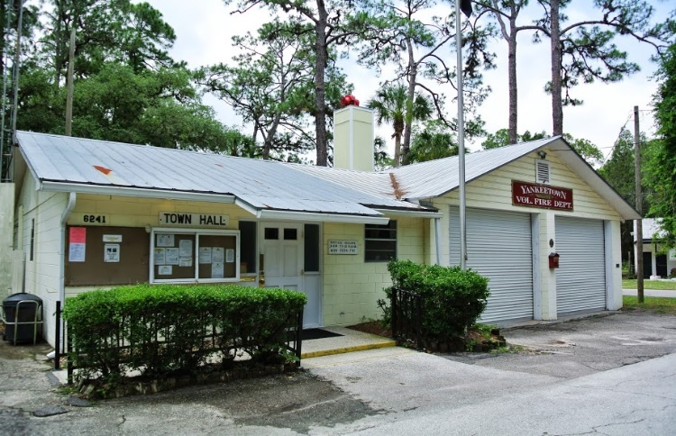
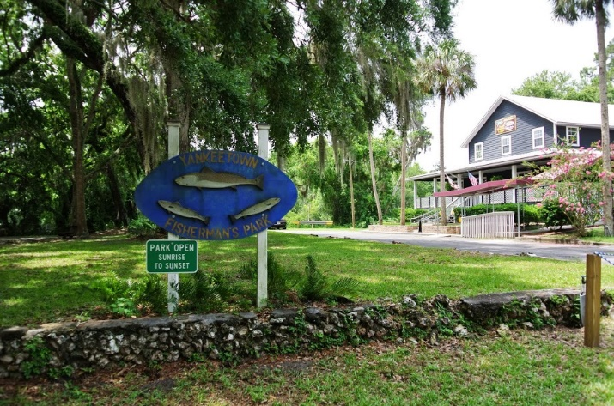
Adaptation Area One
Challenges and Opportunities
  Adaptation to sea level rise, minimizing the negative impacts from inundated infrastructure, and opportunities for ecosystem restoration and adaptation.

Slide 19
Adaptation Area One
Recommendations
  Adapt existing TDR sending area to include AA One.
  Gradually de-invest and relocate civic structures inland.
  Develop incentives to relocate existing private development
  Develop financing and phasing plan to assist in removal of existing infrastructure and structures
    Phasing and transition plan for on-site sewage treatment
AA’s Two and Three may be the receiving areas for relocated development
Develop a plan to assist in ecosystem adaptation, based on the Nat Resource AAA
Notes:
To add to the idea of a phasing plan - develop a program that TRANSITIONS and requires all onsite sewage treatment systems to be performance based systems over a period of time (5 years), then phase that program into a septic removal program when SLR impacts become more apparent

Slide 20
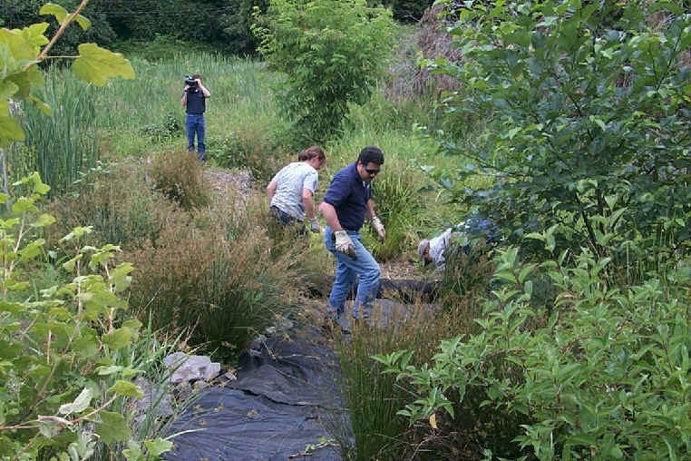
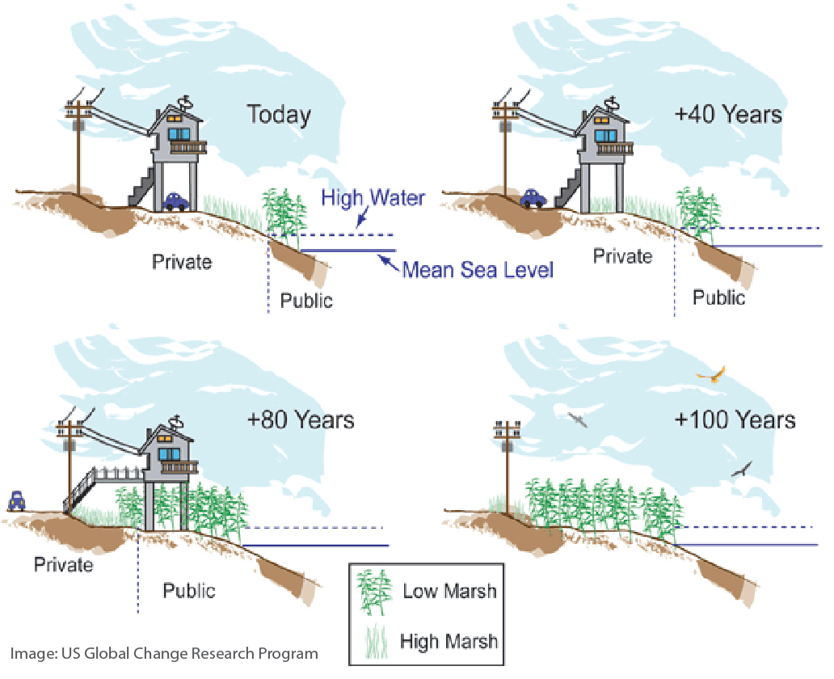
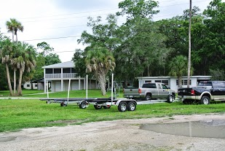
Ecosystem restoration
Gradually relocate inland
Accommodation and compatibility of the built environment

Slide 21
Adaptation Area 1
Discussion

Slide 22
Community Resource Adaptation Action Areas
Notes:
Describe here the overall two pronged approach-
Phased relocation- starting with moderate revision of existing TDR areas
Careful redevelopment and economic stimulus
Map to be updated

Slide 23

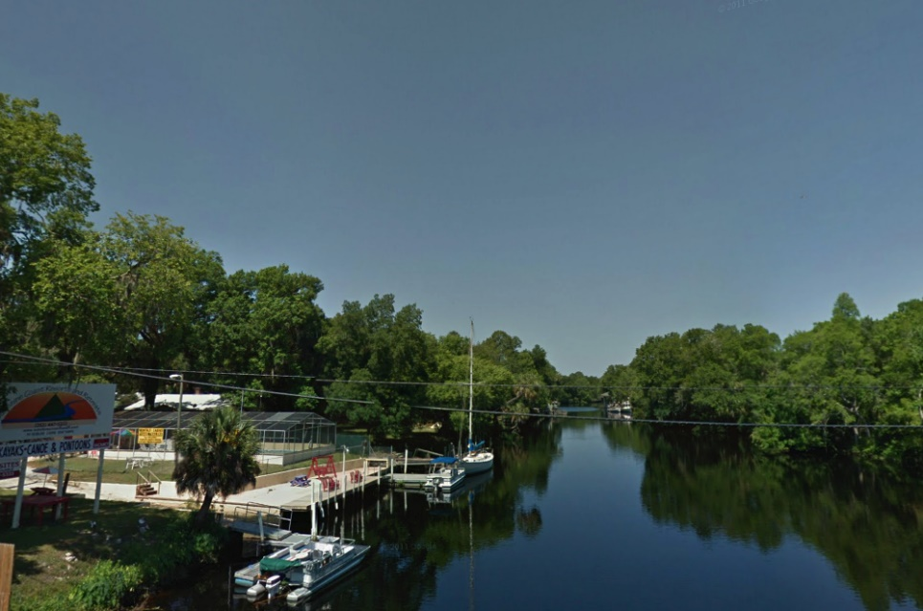
Adaptation Area Two
Challenges/Opportunities
  Opportunities include redevelopment, ecotourism, and waterfront access. Challenges include potential sea level rise impacts.

Slide 24

Adaptation Area Two
Recommendations
  Encourage relocation in areas of extreme hazard, living shorelines, and removal of dangerous infrastructure
  Encourage redevelopment of the waterfront through incentives in areas of lower hazard. Orient towards CR 40.
  Develop a financing and management plan for shoreline restoration and infrastructure removal
  Develop a visual and physical public waterfront access plan
Low impact development strategies, cluster development, and design guidelines
Consider addition as a TDR receiving area for relocated uses in AA 1
Consider zoning changes that incentivize water related or dependent uses
Notes:
-It might be worth mentioning adding infrastructure that can better accommodate clustering of development (Alternative decentralized sewage technologies or cluster sewage systems)
-I see that you mention LID strategies and guidelines, but it might not hurt to elaborate more by mentioning the idea of clustering new development to create visual/physical connections to the river and allowing natural areas around clusters to provide ecosystem services through stormwater drainage, etc. Doesn't necessarily need to be in text and I see that it is in the next slide, but it probably wouldn't hurt to mention here first.

Slide 25
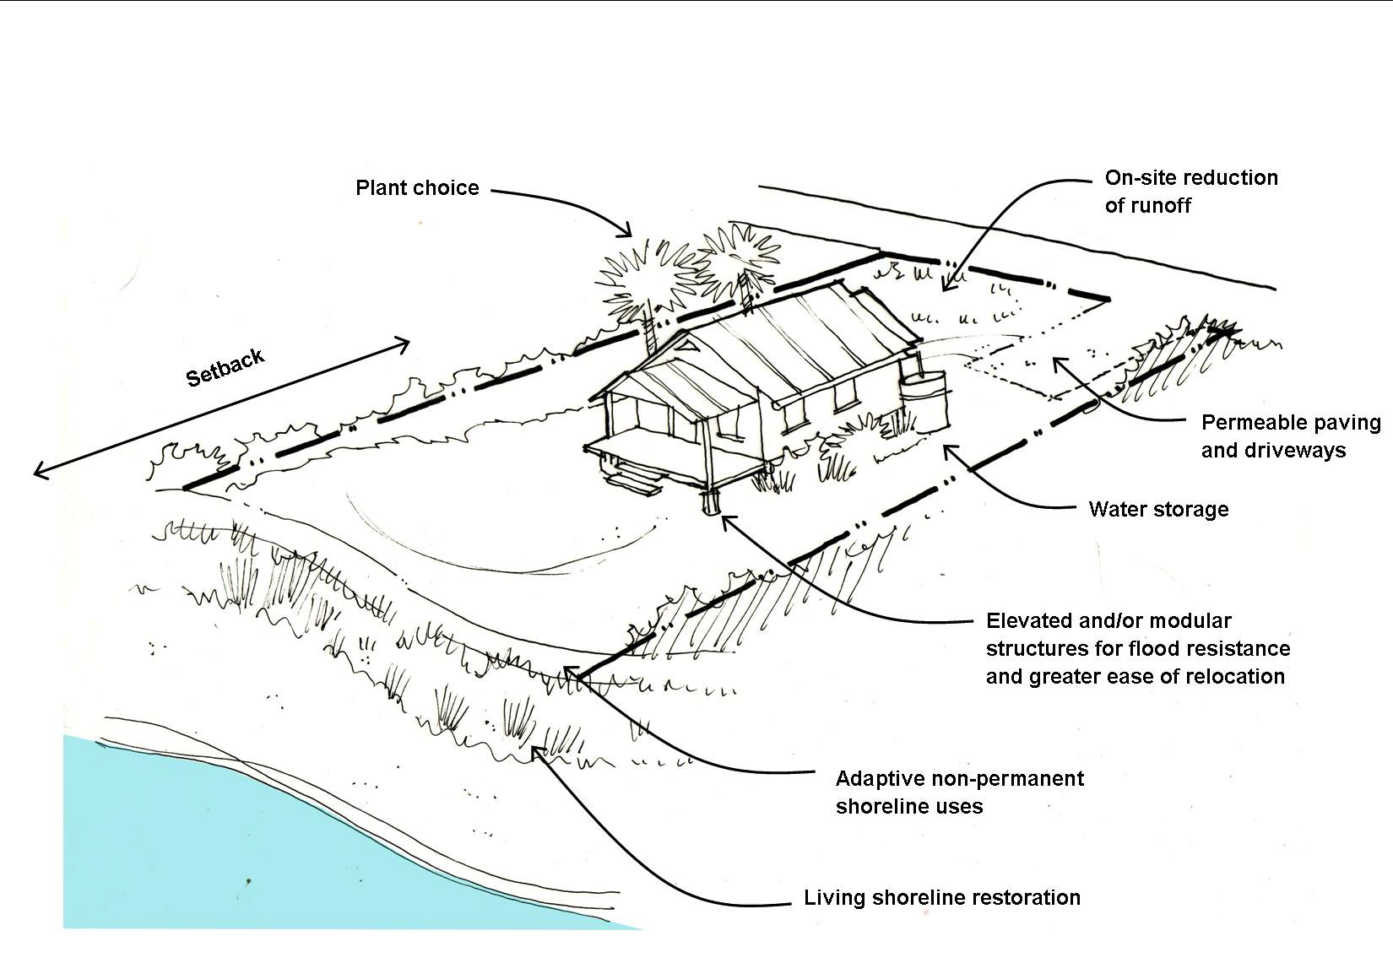
Waterfront Site Design

Slide 26
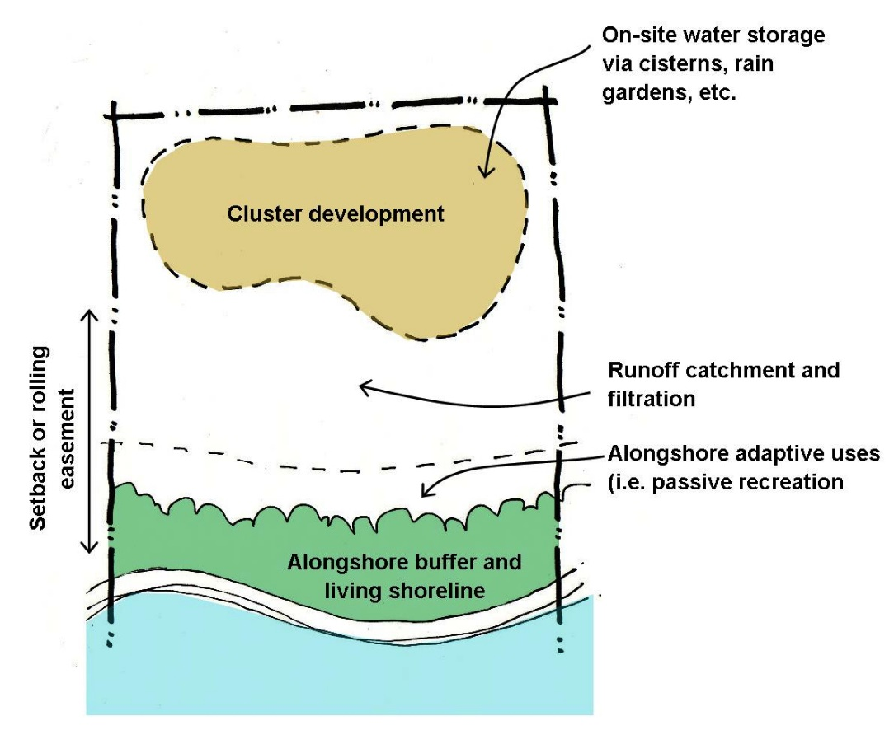
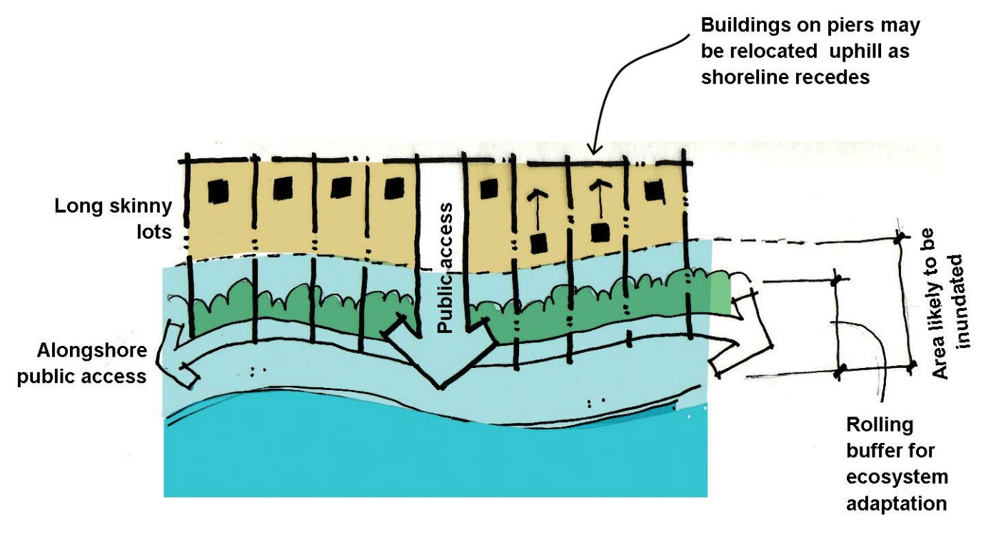
Options for single width lot design
Lot Design Options for
Cluster Development

Slide 27
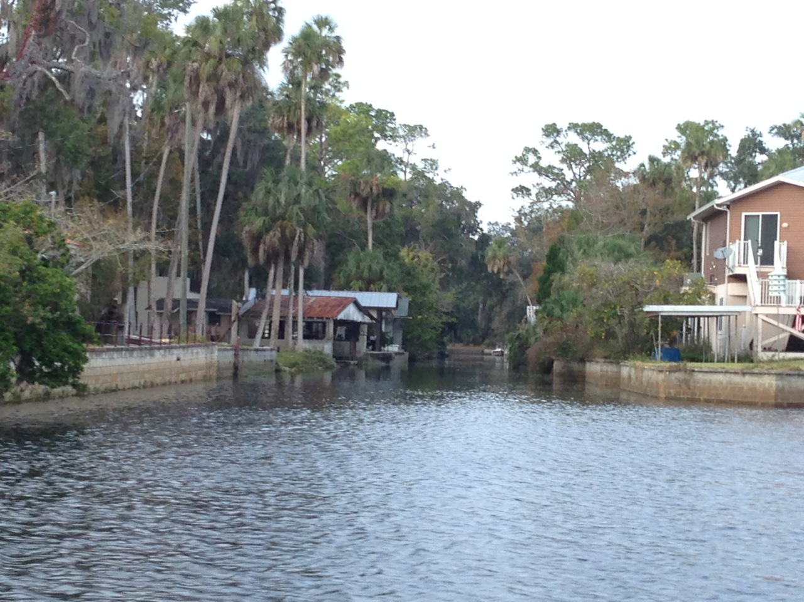
Sea/River Walls and Raised Buildings
(protection and accommodation)

Slide 28
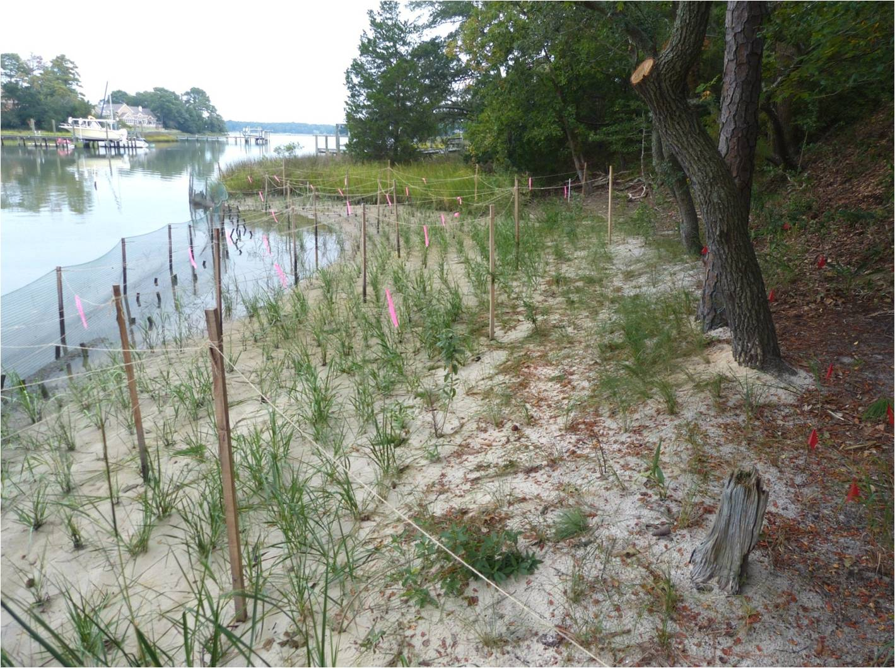
Living shoreline design

Slide 29
Adaptation Area 2
Discussion

Slide 30
Community Resource Adaptation Action Areas
Notes:
Describe here the overall two pronged approach-
Phased relocation- starting with moderate revision of existing TDR areas
Careful redevelopment and economic stimulus
Map to be updated

Slide 31
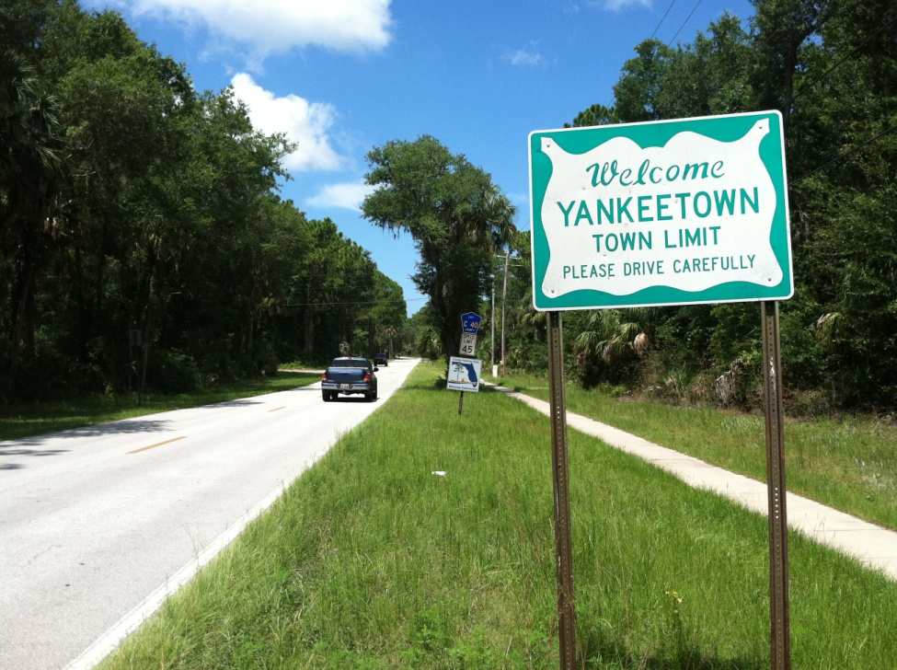
Adaptation Area Three
Challenges/Opportunities:
  Revitalization and moderate redevelopment, particularly along CR 40.
Recommendations:
  Maintain designation as a TDR receiving area
  Remove minimum lot size requirements
  Allow for multi-use development in certain areas

Slide 32
Adaptation Area Three
Recommendations:
  Identify and plan for infrastructure improvements needed for new infill
  Use low impact development strategies
  Create physical and visual connections to SE 193rd Pl
  Orient development towards CR 40.

Slide 33
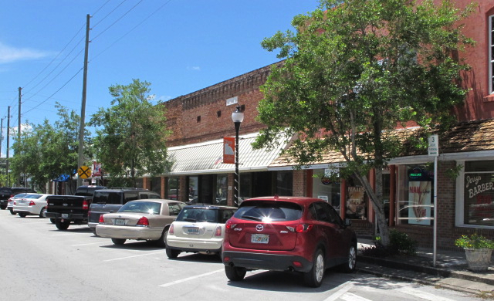
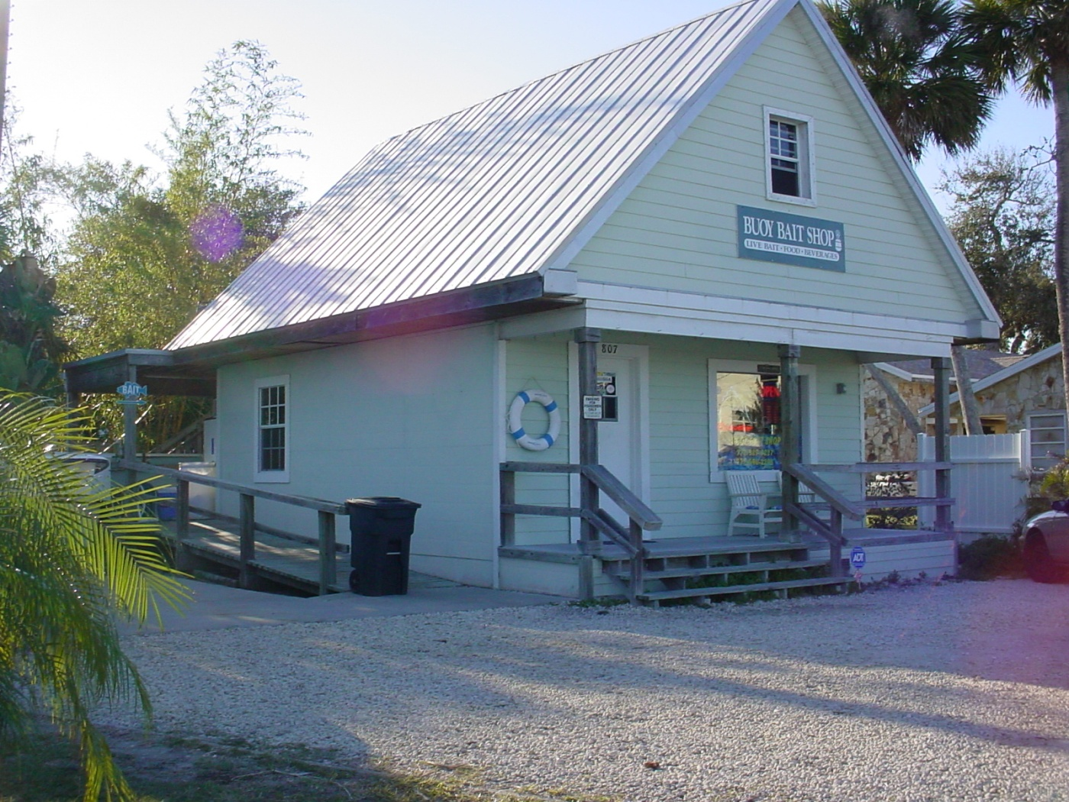
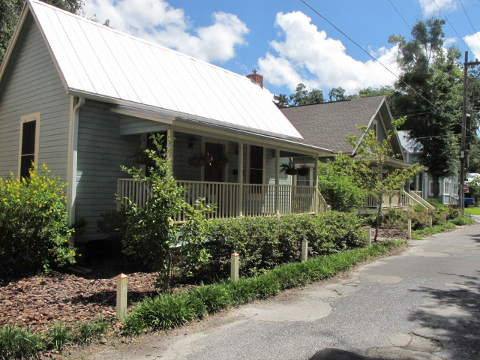
Redevelopment at a lower density and scale, using materials and designs that fit with Yankeetown character

Slide 34
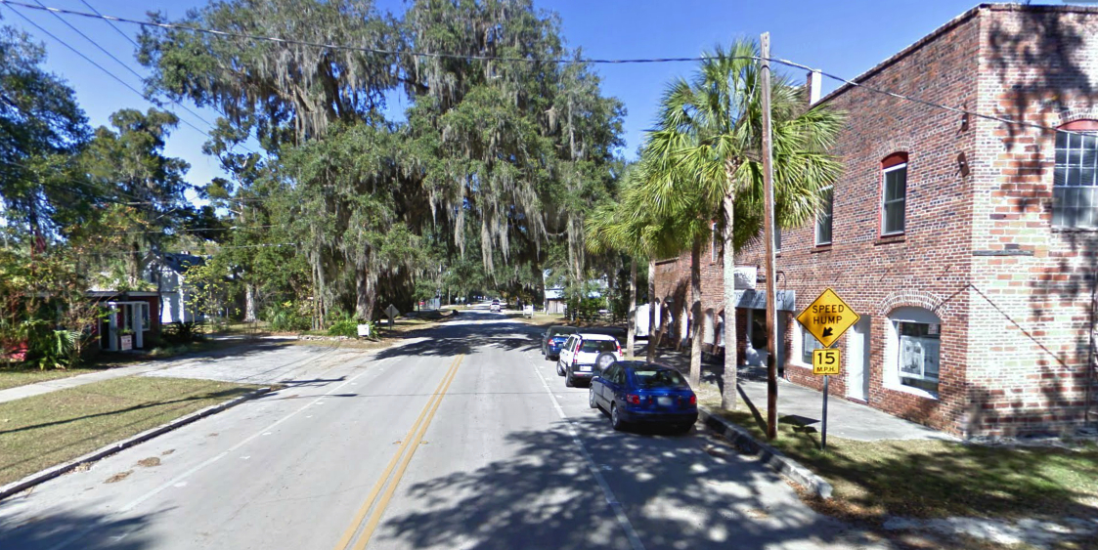
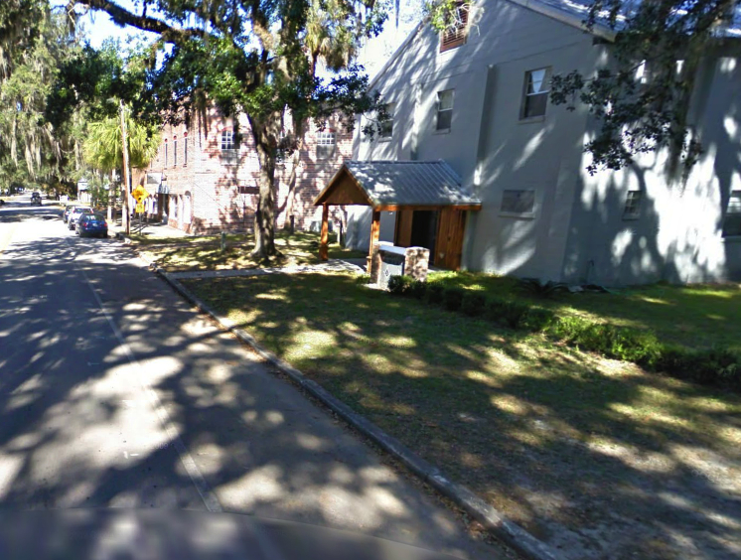
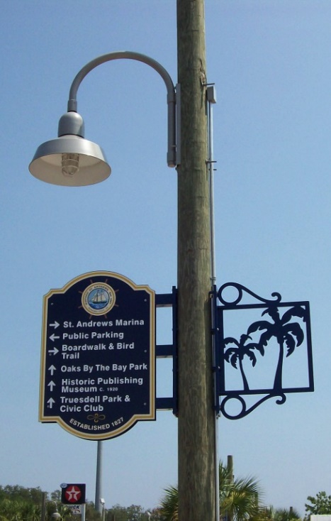
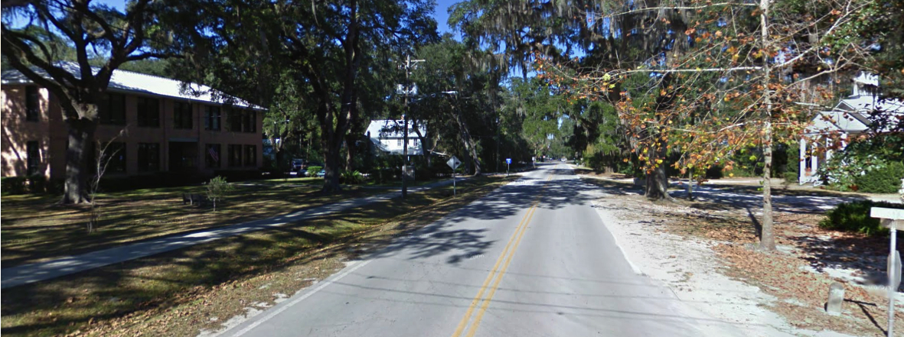

Slide 35
Adaptation Area 3
Discussion

Slide 36
Community Resource Adaptation Action Areas
Notes:
Describe here the overall two pronged approach-
Phased relocation- starting with moderate revision of existing TDR areas
Careful redevelopment and economic stimulus
Map to be updated

Slide 37
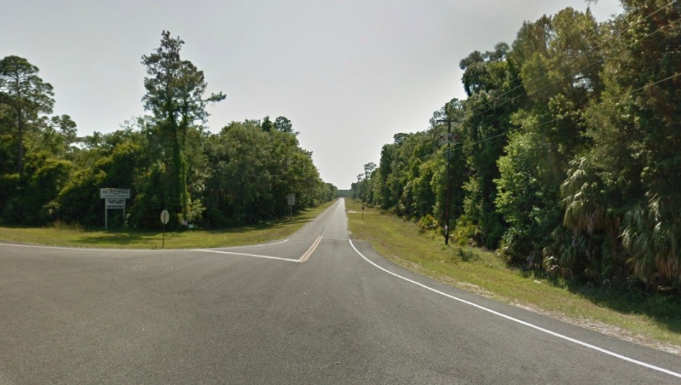
Adaptation Area Four
Challenges/Opportunities:
  Adapting to coastal changes
  Providing a clear and welcoming entrance while maintaining natural character of the corridor
Recommendations:
  New signage and entry design
  Multi-use trail that accommodates coastal change, connects to natural areas, and helps direct people into the town core.
  Maintain and enhance natural and rural character
Insert Photo
Notes:
NR AAA goals should be referenced in the design of this area.

Slide 38
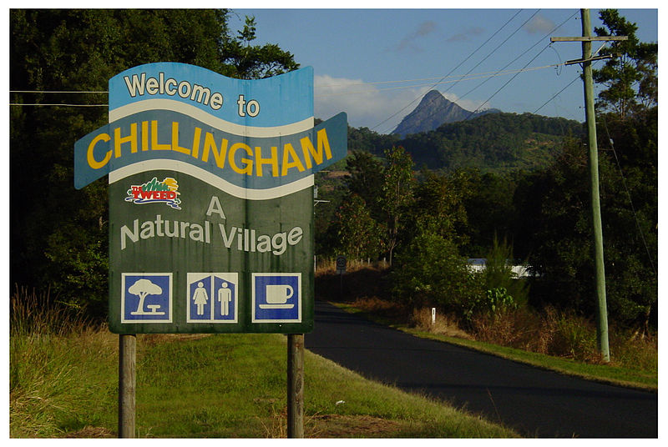
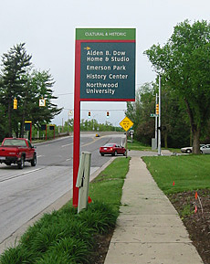
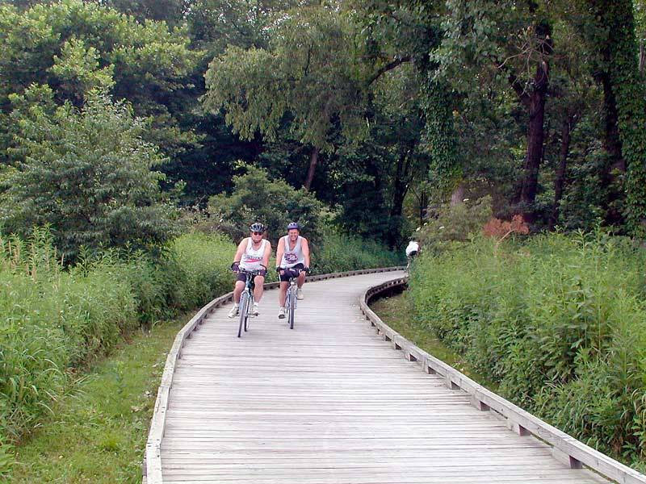
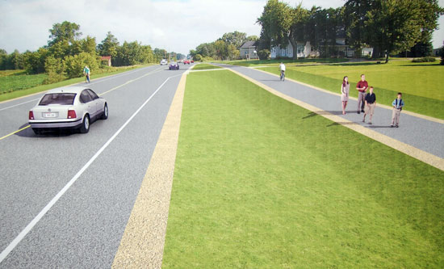
Welcome and way-finding signage, Boardwalk and multi-use trail

Slide 39
Adaptation Area 4
Discussion

Slide 40
Community Resource Adaptation Action Areas
Notes:
Describe here the overall two pronged approach-
Phased relocation- starting with moderate revision of existing TDR areas
Careful redevelopment and economic stimulus
Map to be updated

Slide 41
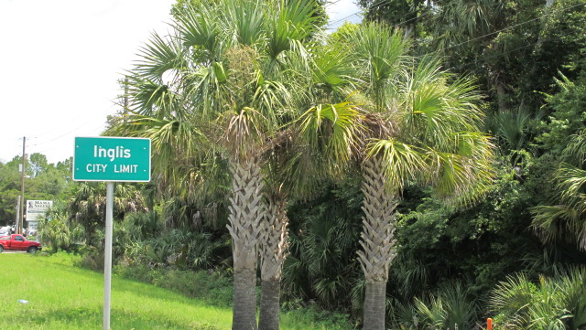
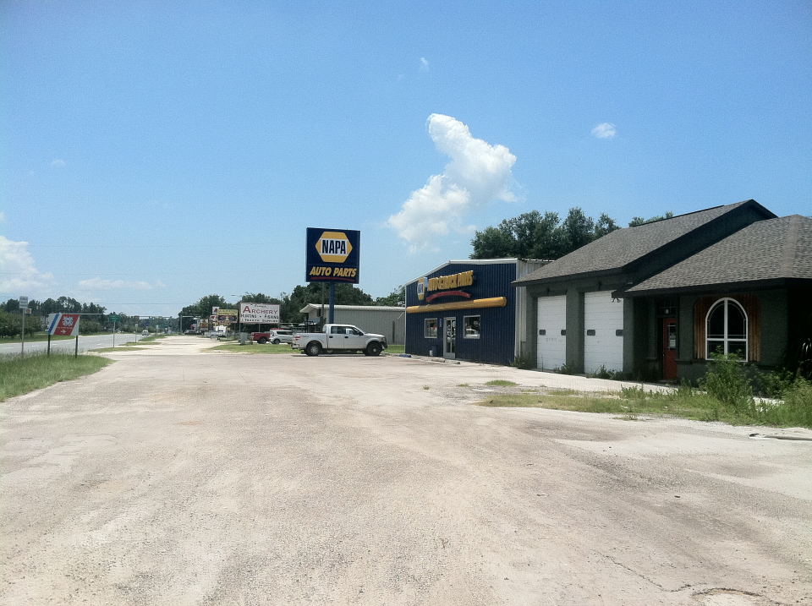
Adaptation Area Five
Challenges/Opportunities: Economic development, accommodate future growth.
Recommendations
  Corridor Plan for CR 40 and US 19
  Physical and visual connections to AA 2
  A redevelopment plan to address social, economic, and infrastructure revitalization
  Low impact development strategies
Insert Photo
Notes:
Our focus for AA’s 5 and 6 is their redevelopment potential as a result from coastal changes

Slide 42
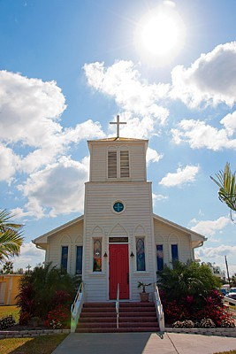
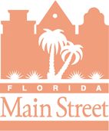
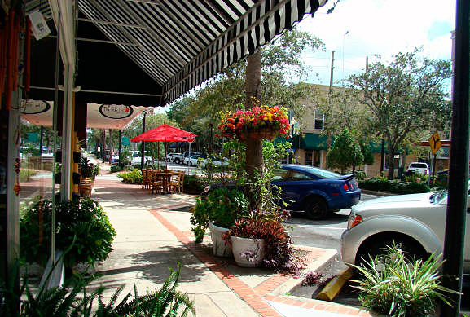
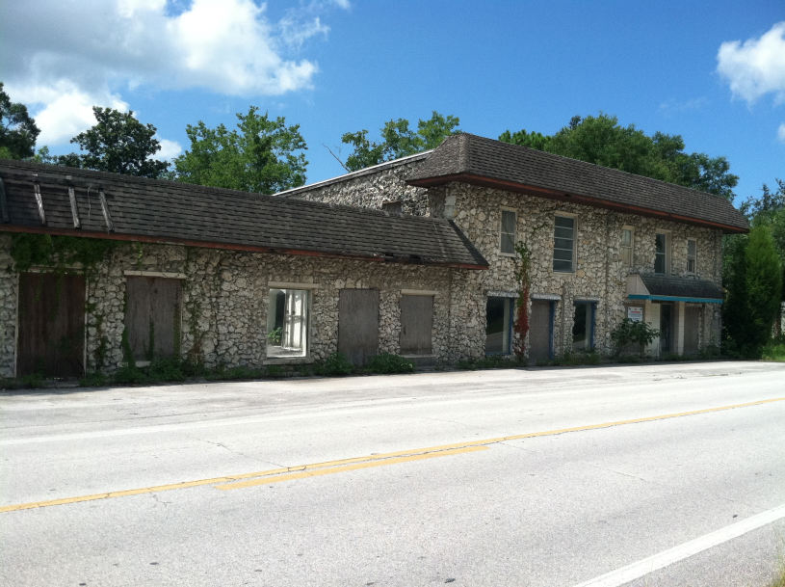
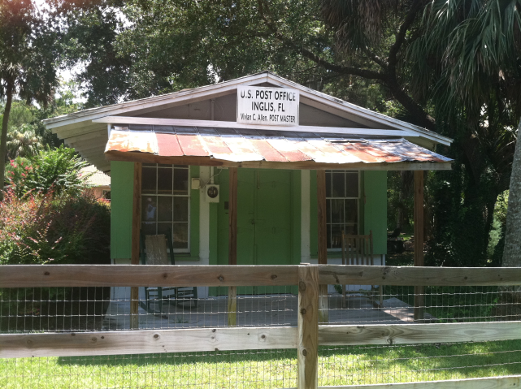
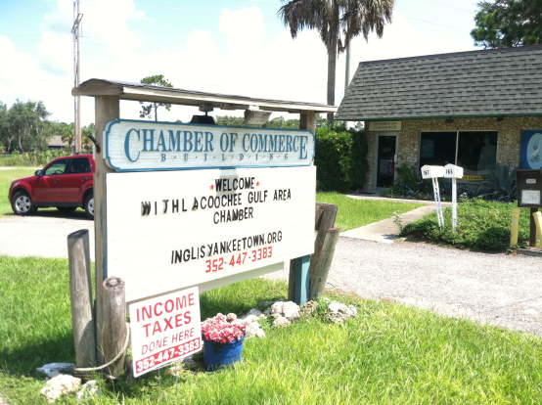
Curb appeal, assets, identity and values

Slide 43
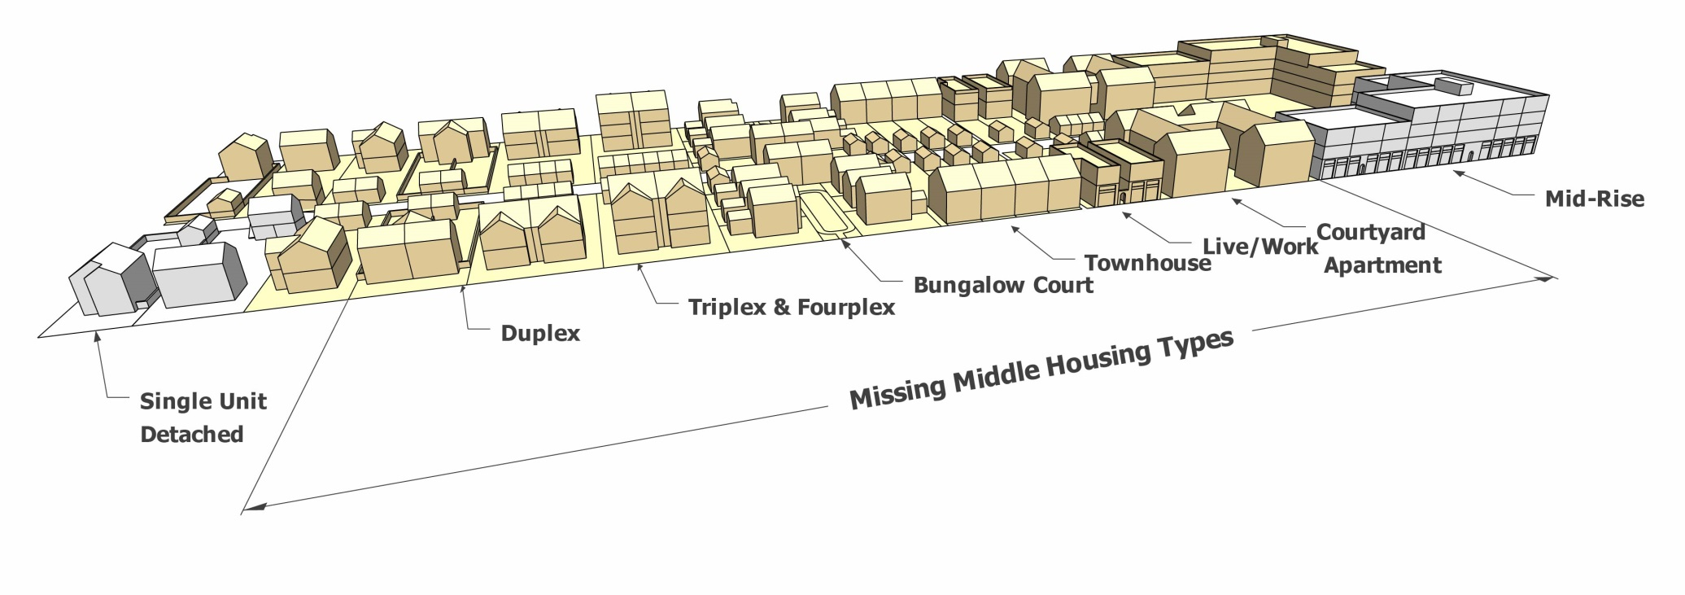
Alternative housing types

Slide 44
Adaptation Area 5
Discussion

Slide 45
Community Resource Adaptation Action Areas
Notes:
Describe here the overall two pronged approach-
Phased relocation- starting with moderate revision of existing TDR areas
Careful redevelopment and economic stimulus
Map to be updated

Slide 46
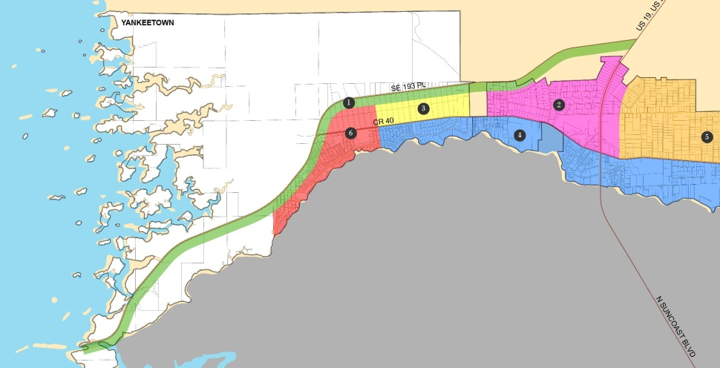
Adaptation Area Six
Challenges/Opportunities: Corridor design, redevelopment, economic and social revitalization
Recommendations:
  Corridor Plan for CR 40
  A redevelopment plan to address social, economic, and infrastructure revitalization
  Low impact development strategies
Notes:
Our focus for AA’s 5 and 6 is their redevelopment potential as a result from coastal changes

Slide 47
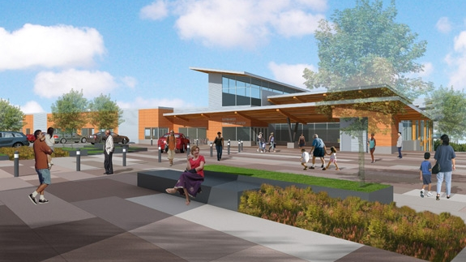
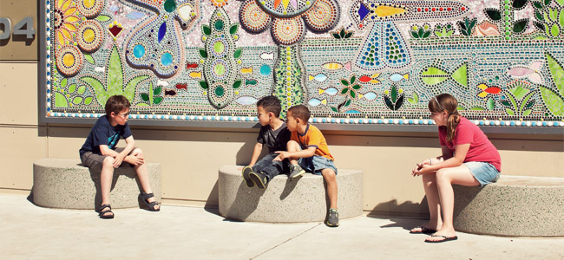
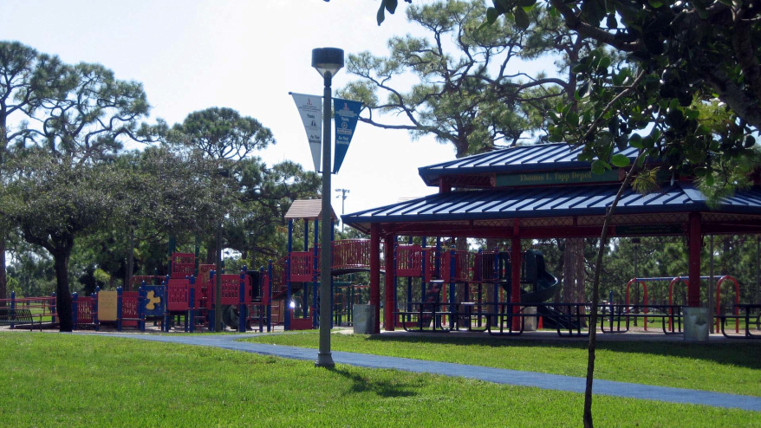
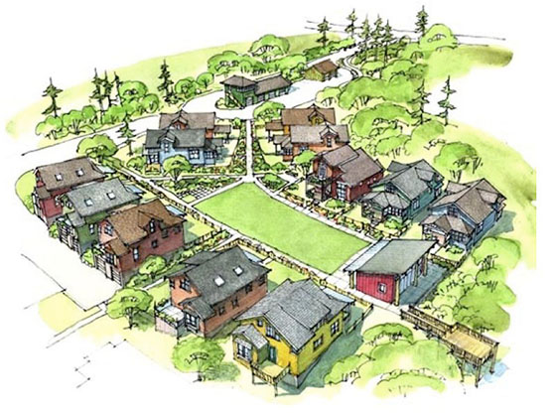
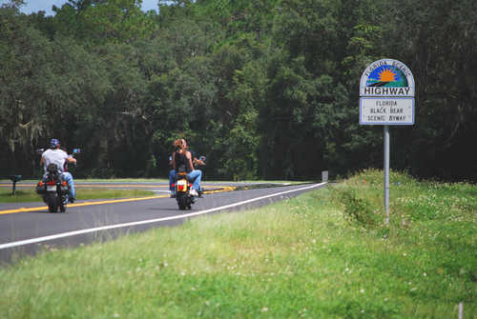
Community, youth, connections
Scenic highway
Pocket neighborhoods

Slide 48
Adaptation Area 6
Discussion

Slide 49
Water Resource Adaptation Strategies
Challenges:
  Current wastewater & sewage treatment infrastructure may become untenable w/ coastal change
    increased flooding can have negative impacts to water quality as drainage fields become increasingly saturated
  Coastal change impacts will require a spatial adjustment in the community (Adaptation Area 1)
    Existing decentralized sewage systems can’t handle changes in the community’s spatial arrangement (infill in developed areas)
  Wastewater and sewage treatment systems in the area are highly constrained by the area’s soil types and the high water table
  Water supply may become increasingly vulnerable to saltwater intrusion in the future
Notes:
Spatial adjustment – currently low density and spread out spatially ➔ coastal change affecting western portions of Yankeetown will require a spatial adjustment, the current form of low density cannot be maintained.

Slide 50
Water Resource Adaptation Strategies
Recommendations:
  Further study on the impacts of coastal change on wastewater and sewage systems and water supply for the area
  Look at where decentralized cluster systems and advanced treatment technologies can be used to accommodate clustering and infill development to accommodate adaptation
  Identify areas where central sewer is appropriate (areas with unsuitable soils for decentralized systems, or where increased density is desired)
  Develop a plan/program for phasing in newer wastewater and sewage treatment systems and septic removal in adaptation areas
  Water Supply
    Try to maintain groundwater recharge and ecosystem services where new development occurs through Low Impact Development strategies
    Be cognizant of saltwater intrusion when siting new wells
Notes:
-Advanced treatment systems encompass a broad range of technologies. The unifying feature is a separate treatment unit next to the septic tank that treats the effluent before it is discharged to the drainfield (a below-ground absorption field, also called a leach field).

Slide 51
Community Resource Adaptation Action Areas
Notes:
Describe here the overall two pronged approach-
Phased relocation- starting with moderate revision of existing TDR areas
Careful redevelopment and economic stimulus
Map to be updated

Slide 52
Water and Wastewater
Discussion

Slide 53
Broad Recommendations
Approaches
Holistic, multi-pronged approach to redevelpoment while addressing coastal change incrementally
Targeted investment/de-investment and a broad range of policies
Partnerships with State, County, and local governments
Enhance functional connections with Citrus County (land and water transportation, economic, social)
Integration of natural and built environment priorities

Slide 54
Broad Recommendations
Recommendations
Performance guidelines- to ensure that new development is compatible with local goals (infrastructure compatibility, public amenity/economic benefits).
Design guidelines in keeping with existing/desired community character in all Action Areas.
Low impact development strategies for new development in all Action Areas
Separate Corridor Plans for US 19 and CR 40 addressing redevelopment and pedestrian accessibility.
Infrastructure Plan to address coastal change impacts to utilities. This should include long term investment/de-investment plans, relocation plans, and be flexible
A Post-disaster Redevelopment Plan
A Relocation Plan that outlines incentives for development relocation from hazardous areas.

Slide 55
Closing Remarks and Next Steps
ChangingLevyCoast.org

