Slide 1
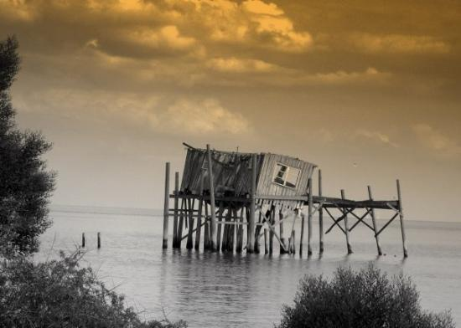
Cedar Key, Florida
A History of Resilience

Slide 2
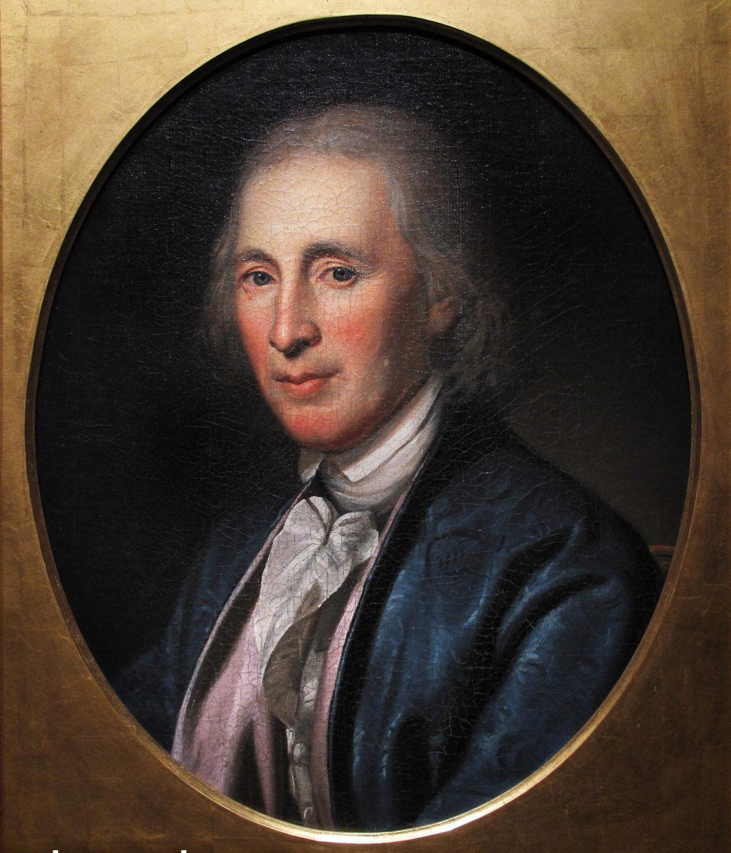
“Change is hard!”
David Rittenhouse
1st Director of US Mint

Slide 3
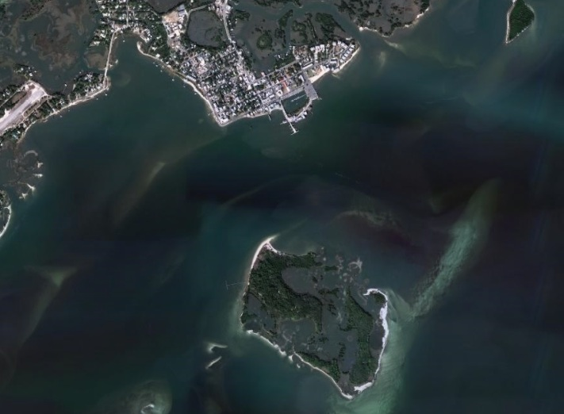

Slide 4
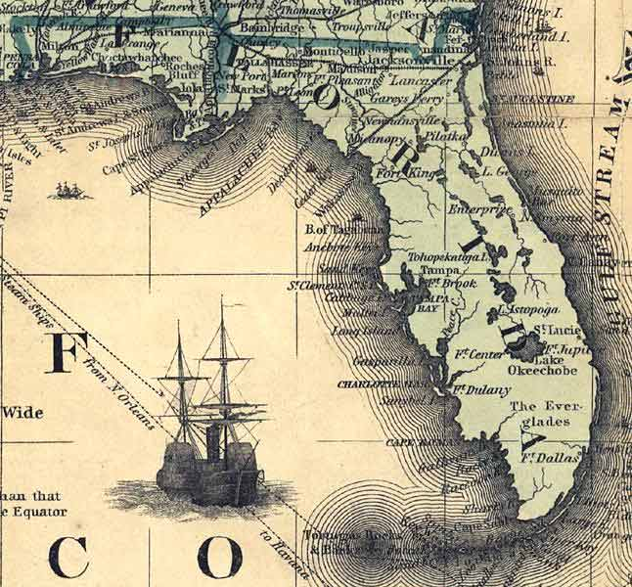
Early Years
Originally populated by Native Americans
Used as a trading post in First Seminole War
Made a U.S. Territory in 1821
In 1935, US constructed a hospital and stockade

Slide 5
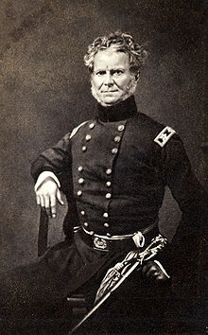
Served as military outpost in Second Seminole War
Headquarters of the Army of the South
Col William J Worth declared war to be over here on August 14, 1842

Slide 6
Devastation & Economic Growth
Island was devastated by massive hurricane in October 1842
Armed Occupation Act of 1842 allowed civilian settlement and Native American relocations
Resort hotel construction began in 1843 by US Customs House officer Augustus Steele
Trade prospered during 1850’s and name of town was changed to Cedar Key
Primary products were cotton, tobacco, turpentine and rosin
Warehouses and rail terminal were constructed

Slide 7
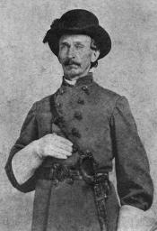
Civil War
Time of economic hardship
Union blockade halted shipping and fishing activities
In the Battle of Cedar Key on January 7, 1862, Union forces attacked and destroyed rail head and harbor facilities
Defended by Capt. JJ Dickinson

Slide 8
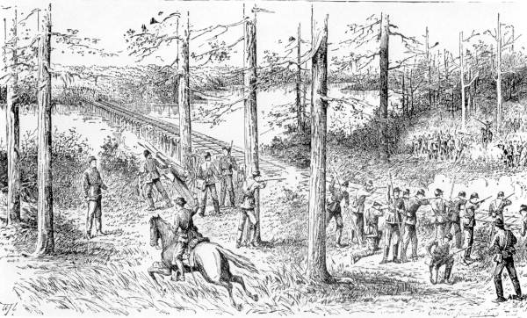

Slide 9
Reconstruction, Devastation & Relocation
Notes:
A second massive hurricane and 10 foot tidal surge devastated the island on September 29, 1896

Slide 10
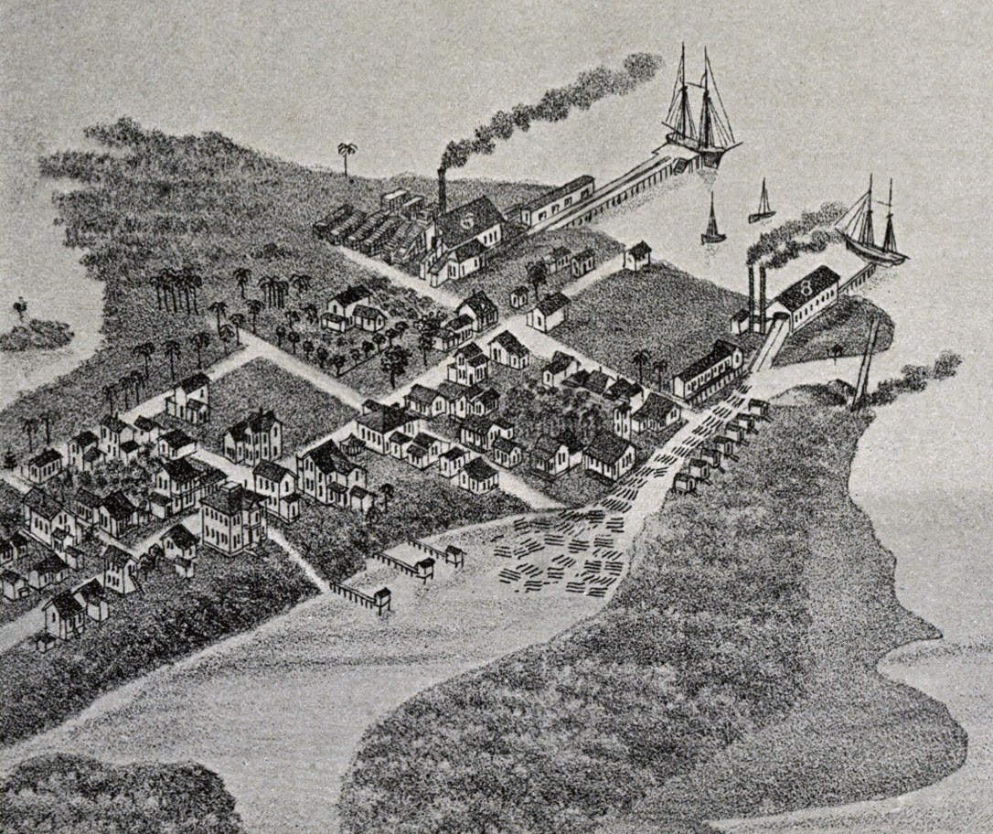
Notes:
1. In 1968, the Eberhard Faber Pencil Company located on the island
2. By 1870’s economy had rebounded

Slide 11
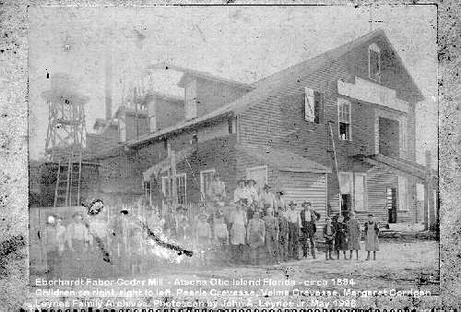
Eberhard Faber Pencil Factory

Slide 12
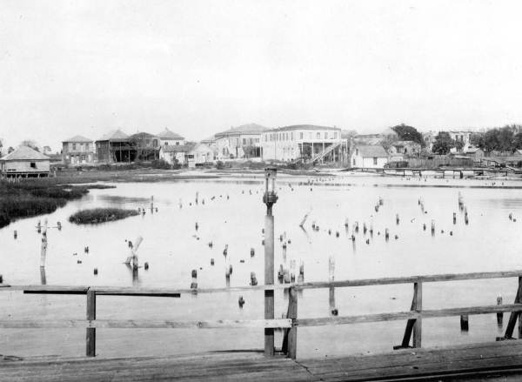
Notes:
View of the waterfront - 1874

Slide 13
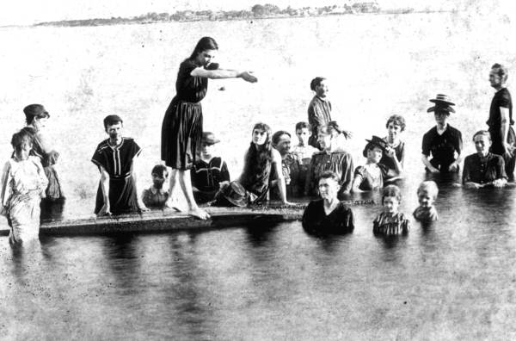

Slide 14
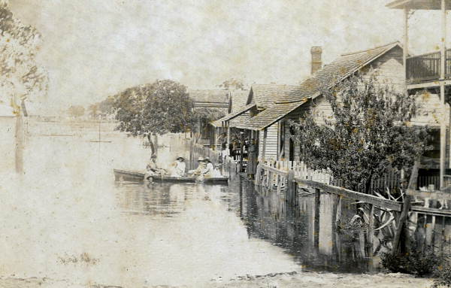
Hurricane of 1896

Slide 15
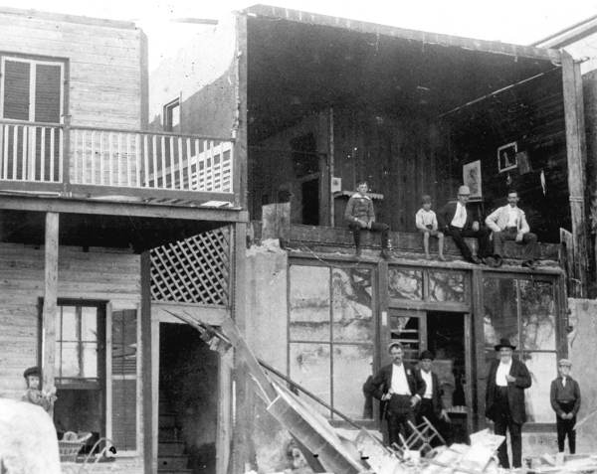

Slide 16
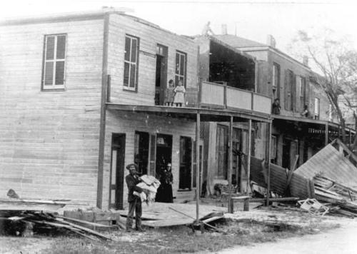

Slide 17
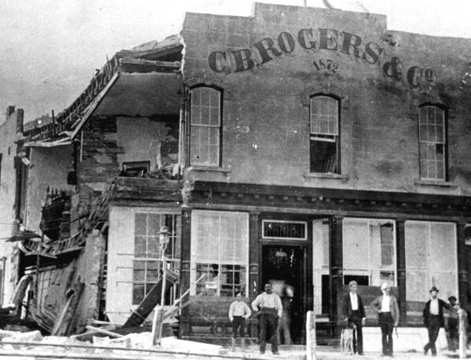

Slide 18
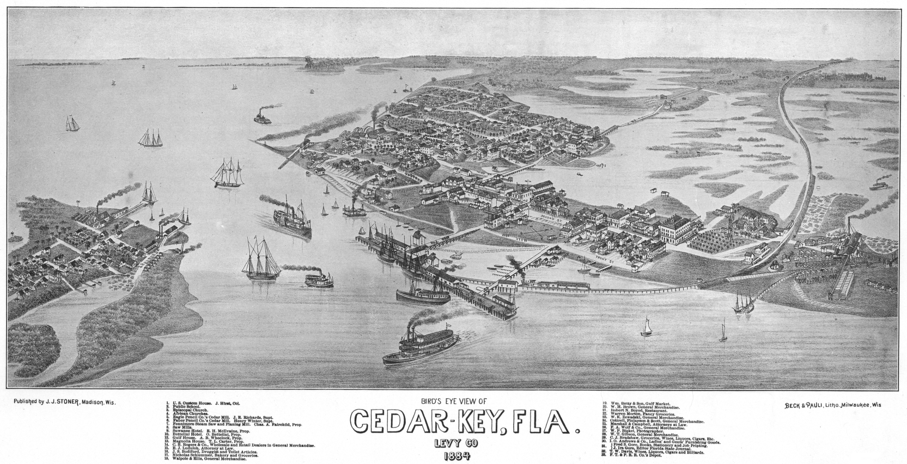
Relocation
Town was abandoned and relocated to it’s present location

Slide 19
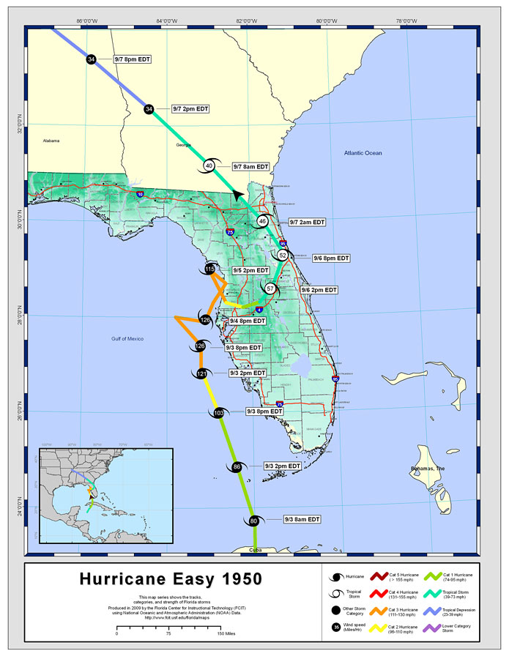
Hurricane Easy
September 1950
Packed winds of 125 mph
Dropped 38.7 inches of rain in 24 hours
Destroyed half of Cedar Key’s homes

Slide 20
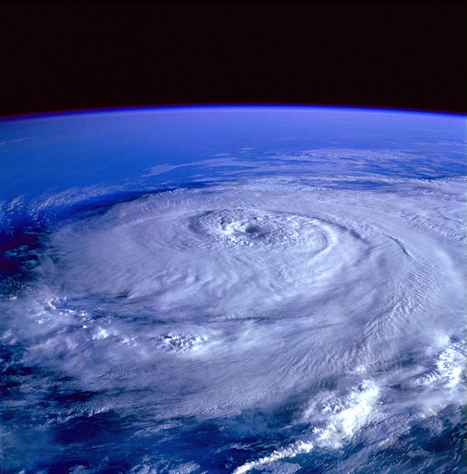
Hurricane Elena
September 1985
Packed winds of 115 mph
Churned 50 miles to the west for two days battering the coast
Businesses on Dock Street were damaged or destroyed

Slide 21
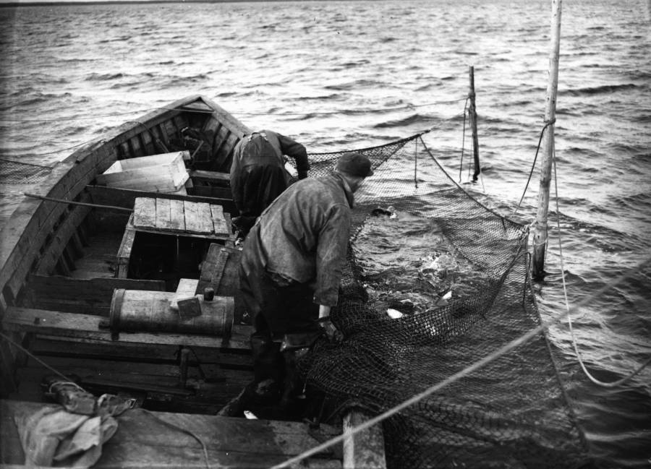
Net Fishing Ban

Slide 22
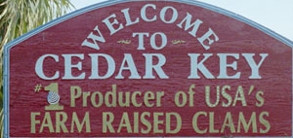
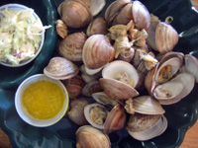
Statewide ban an went into effect on July 1, 1995
Government retraining program assisted local fisherman begin farming clams
Today Cedar Key's clam-based aquaculture is a multi-million dollar industry

Slide 23
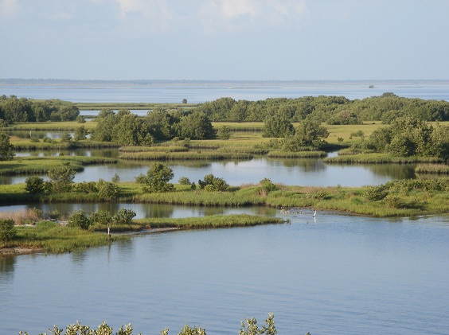

Slide 24
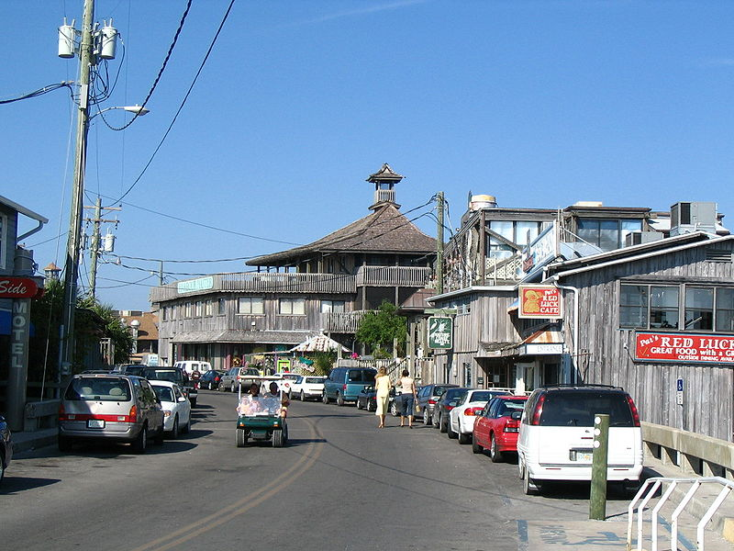

Slide 25
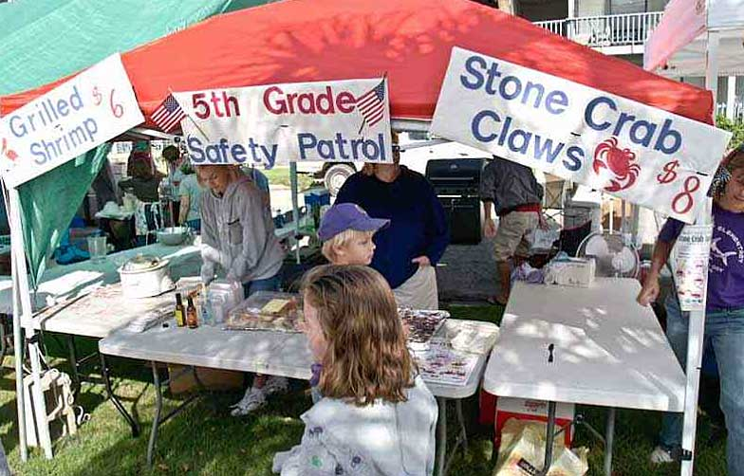

Slide 26
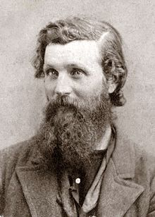
“For nineteen years my vision was bounded by forests, but today, emerging from a multitude of tropical plants, I beheld the Gulf of Mexico stretching away unbounded, except by the sky. What dreams and speculative matter for thought arose as I stood on the strand, gazing out on the burnished, treeless plain!”
^{John Muir}
A Thousand-Mile Walk to the Gulf
¹⁸⁶⁷

