Slide 1
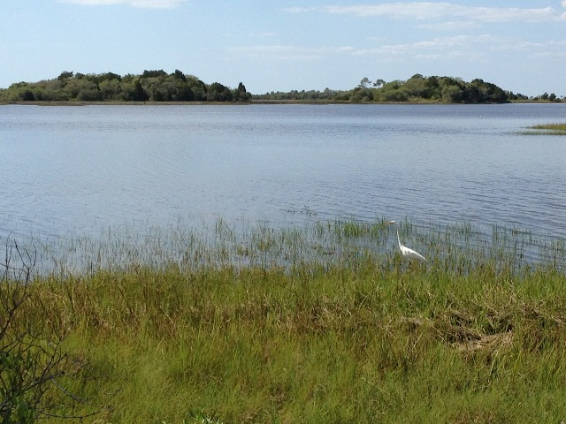
Coastal Change:
Examining Changes in Coastal Habitat in Levy County
Sean Reiss – University of Florida, Department of Urban and Regional Planning

Slide 2
Presentation Overview
Introduction
What causes coastal habitat migration?
How has the coast changed in Levy County?
How will coastal habitats migrate in the future?
What does this mean for me?

Slide 3
Introduction
Changes in the coastal habitat have happened in the past and will continue into the future
  Sea levels have been rising for the past 18,000 years
  Human development contributes
Trend of an inland movement of coastal habitat since the last glacial period as oceans have risen
  This shift has occurred at varying rates of speed
  There is reason to believe we are moving into a period of faster rates of rise in sea level
Notes:
-Average 6mm per year. Have seen periods of 40mm/yr in past 6000-8000yrs. 16mm/yr results in complete inundation of marshes->migration cant keep up with rate of rise

Slide 4
What causes coastal habitat migration?
Coastlines are in a constant state of give and take
  Sediment deposition (accretion) builds coastlines
  Coastal erosion takes coastline away, or moves them around (think coastal inlets)
Higher sea levels result in:
  Increased salinity in coastline areas
  More frequent flooding events and exposure to storm surge and wave forces
  Alters the ecosystem ➔ coastline and saltwater marshes move inland, often displacing coastal forests

Slide 5
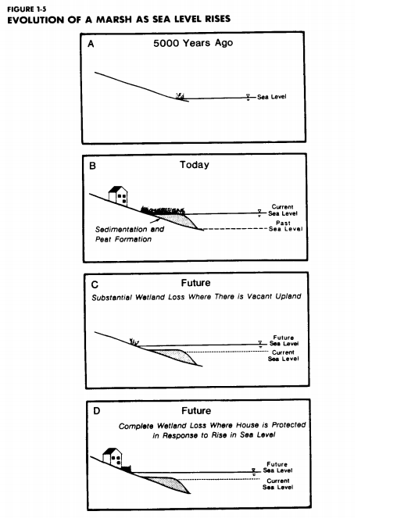
Titus, 1988

Slide 6
How has coastal habitat changed in Levy County?
A recent United States Geologic Survey (USGS) study used old maps, nautical charts, and aerial images dating back to 19th century to look at how the coastal habitats have changed
    Historic Topographic Sheets to Satellite Imagery: A Methodology for Evaluating Coastal Change in Florida's Big Bend Tidal Marsh – Raabe et al., 2004
Verdict: MARSHES ARE ON THE MOVE!!!
  Inland migration of marshes and losses in coastal forest were the trend

Slide 7
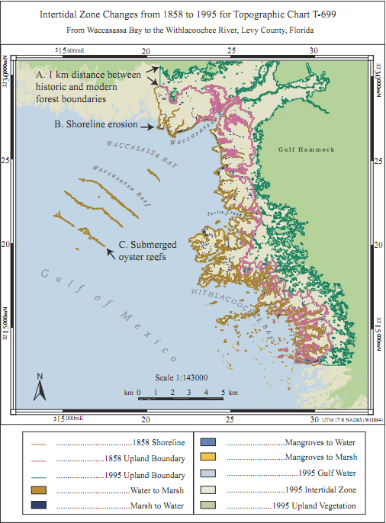

Slide 8
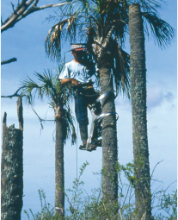
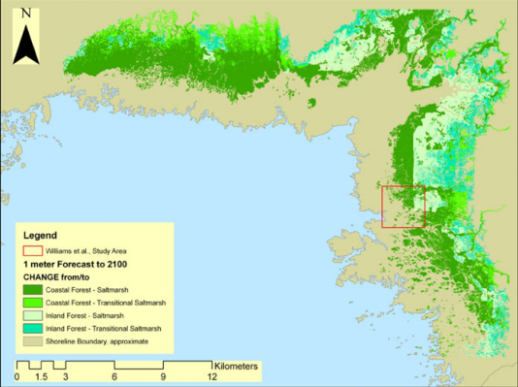
How will coastal habitats migrate in the future?
Currently, researchers are examining the decline in coastal forests in Waccasassa Bay and the Withlacoochee Gulf Preserve
  Use field plot data and the Sea Level Affecting Marshes Model (SLAMM)
Left: A scientist collecting data in the field
Right: SLAMM results depicting coastal forest transitioning to marsh with 1 meter of sea level rise (Geselbracht et al, 2011)

Slide 9
How will coastal habitats migrate in the future?
Retreat of coastal forest continues, and will likely continue as they are displaced by inland migrating marshes
  Predict net loss of inland forests and net gain of tidal flats too
  Decline is attributed to chronic long term stresses resulting from higher sea levels and periodic disturbances from intense storm and drought events
  Increasing presence of mangroves in Levy County

Slide 10
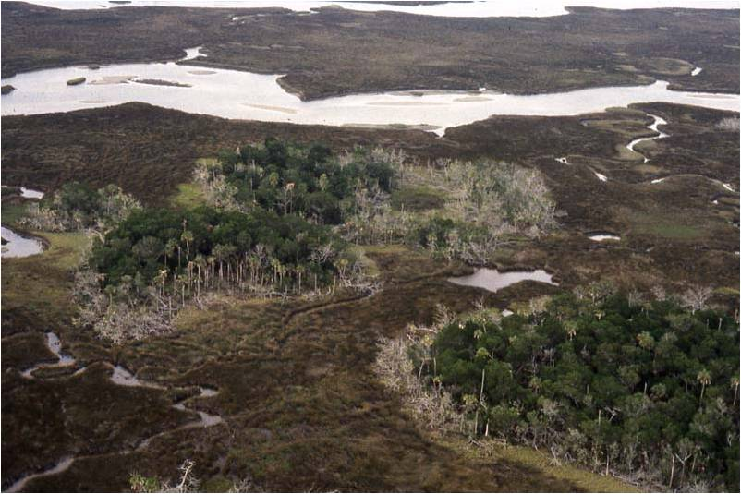
Declining coastal hammock in the Withlacoochee Gulf Preserve
Photo Credit: Jack Putz

Slide 11

Have you noticed any changes along the coast?

Slide 12
What does this mean for me?
Things will look different in the future
    More open water
    More saltwater marsh
    Less coastal forests and hammocks
We may lose existing conservation lands to permanent flooding

Slide 13
What does this mean for me?
Migrating coastal habitats and human development may be competing for the same land
  Result - We should plan ahead to:
    Avoid land use conflicts
    Better prioritize land allocation and conservation efforts
    Maintain critical ecological corridors

Slide 14
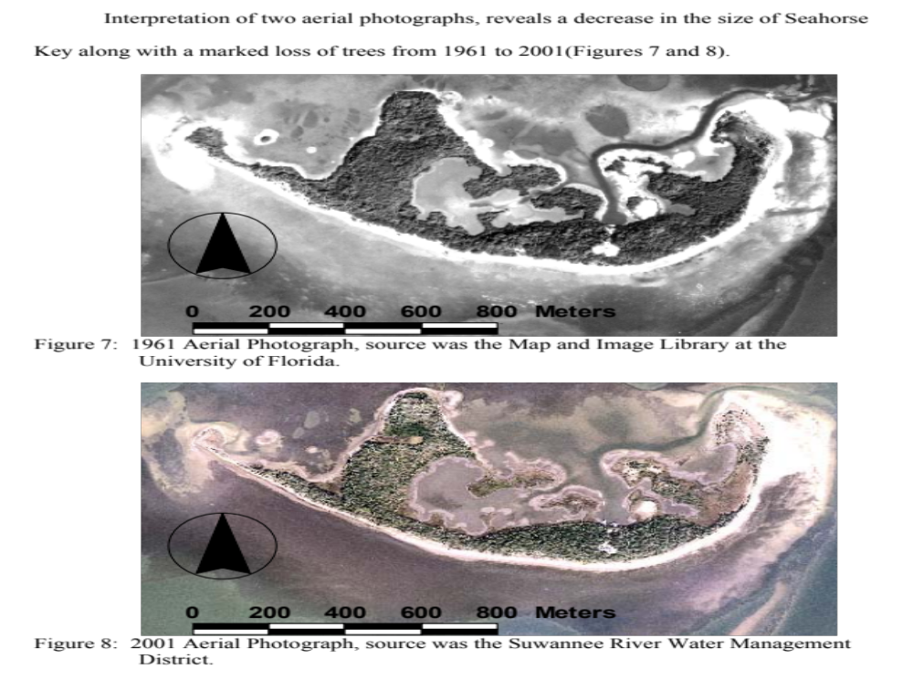
Questions? Comments?

Slide 15

PRETEND THESE ARE GIGANTIC POSTERS!!!!

