Slide 1

Levy County Coastal Change
Art Project
Expressing Change in Levy County
November 15, 2013
Cedar Key Arts Center

Slide 2
Expressing Change
Goal: To creatively express the challenges and opportunities of the changing coast in Levy County
Approaches can vary:
  Raising awareness
    Broad or narrow topics like salt water intrusion, the Suwanee, the seafood industry, collaging maps, biographical/place sketches
    Social/economic/ecological aspects
  Creating a vision
    What nature might create, what people might create…
    Alternative perspectives
  Tapping into the emotions of change:
    hope, loss, uncertainty, resilience, interdependence…
  Themes of change over time, losses versus opportunities, human & nature relationship

Slide 3
Excursion Agenda
10am Welcome & Discussion
11am Tidewater Tours
1pm Lunch
3:30 Tour with Sue Colson
4:30 Final Questions/Discussion and Departure

Slide 4
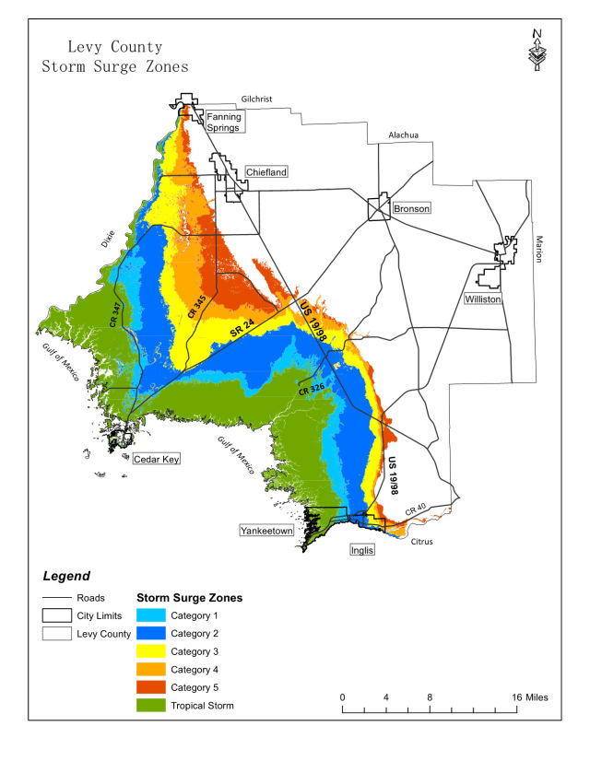
Context

Slide 5
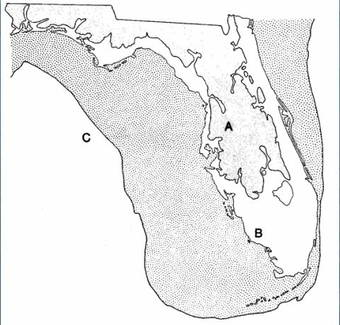
Context
Coastlines are dynamic and always in a state of change
  Sea levels have been rising for the past 18,000 years
The coastline has been moving landward since the last glacial period as oceans have risen
  This shift has occurred at varying rates of speed
  There is reason to believe we are moving into a period of faster rates of rise in sea level

Slide 6
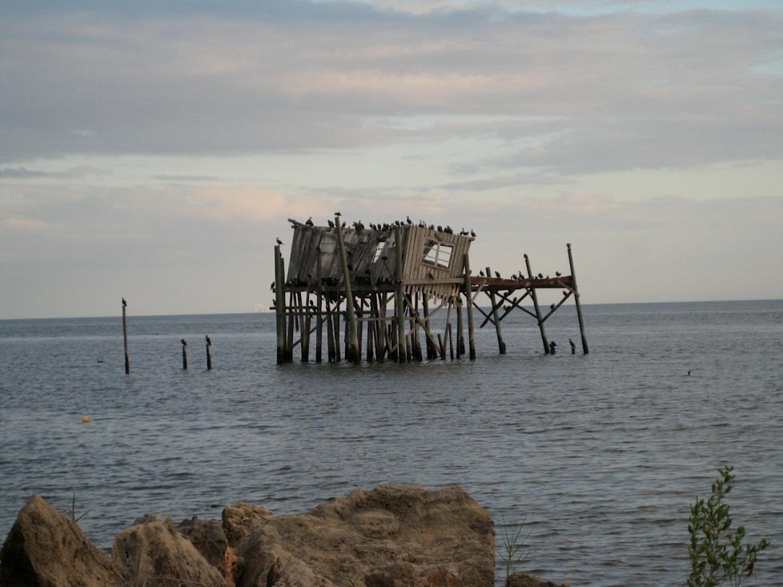
Coastal Change and Impacts of Sea Level Rise
What is coastal change?
Sudden changes
  Hurricanes and floods
Intermediate change
  Salt water intrusion and erosion
Slow change
  Sea level rise

Slide 7
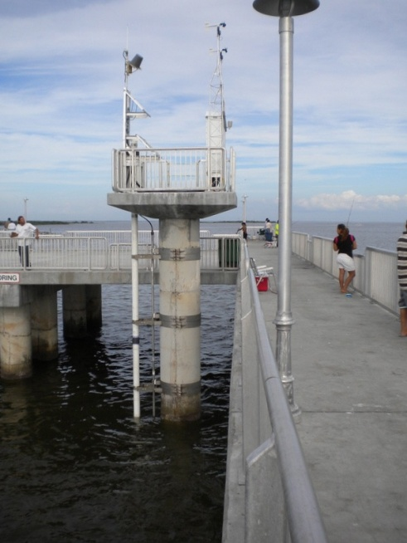
Past Sea Level Rise in Levy County
8 inches

Slide 8
Coastal Change and
Impacts of Sea Level Rise Today
Habitat and species changes (moving marshes and loss of coastal forests)
More frequent flooding at high tide
Erosion and corrosion of infrastructure
Release of pollutants
Saltwater intrusion into aquifers
Storm surges farther inland
All of these are
intensified by sea
level rise

Slide 9
Sea Level Rise Projections for Levy County
US Army Corps of Engineers Guidance
1.5 to 5 feet
Projected Sea Level Rise Range
Historic Cedar Key Sea Level Rise Rate for Comparison
(8 inches per 100 years)
5
4
3
3 feet
Sea Level Rise in Feet
0.5 to 1.5 feet
2
1
2010
2050
2100

Slide 10
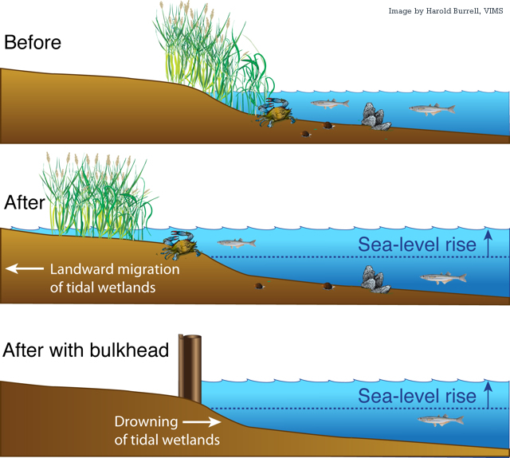

Slide 11
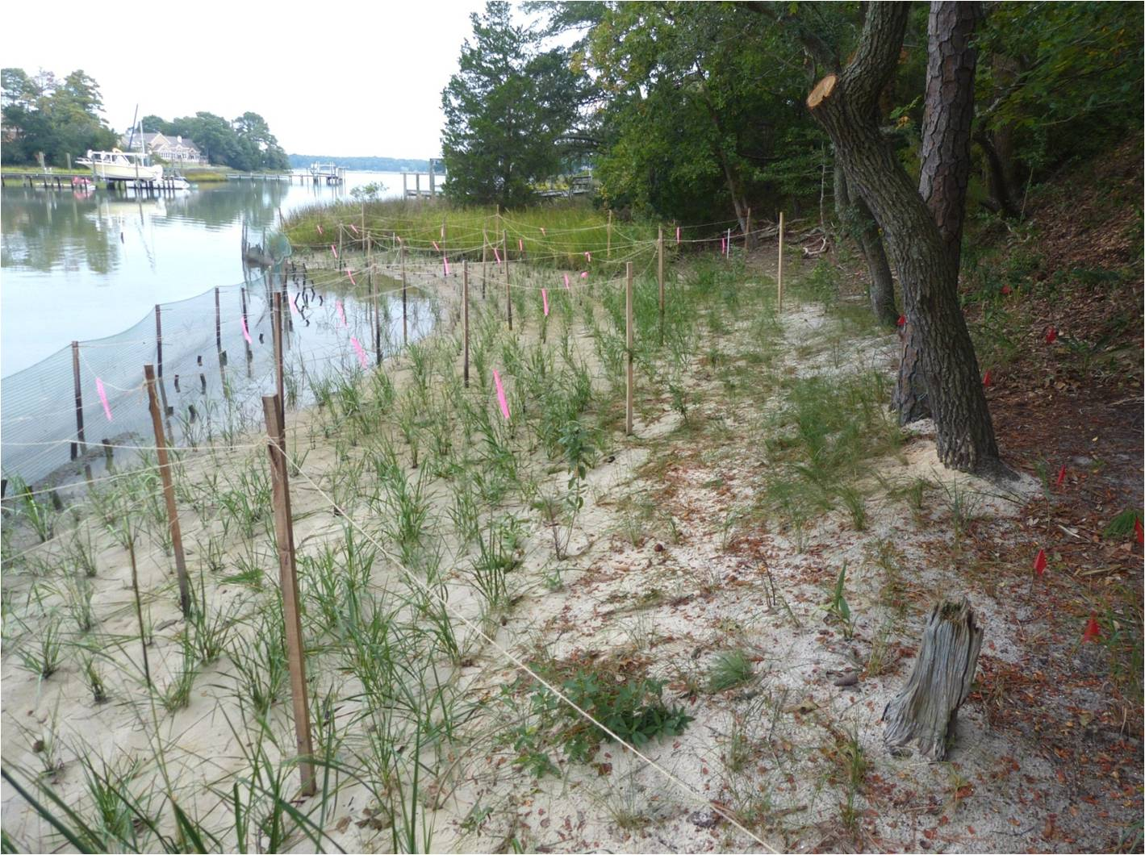
Living shoreline design

Slide 12
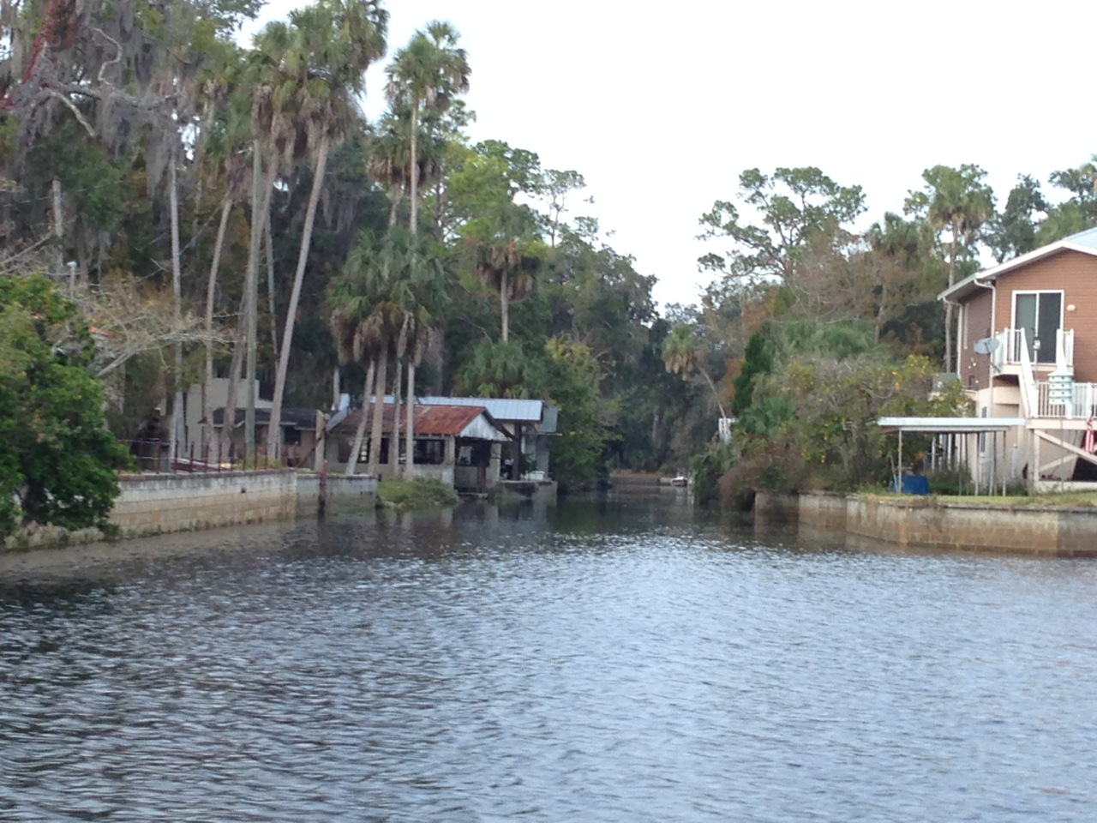
Sea/River Walls and Raised Buildings
(protection and accommodation)

Slide 13
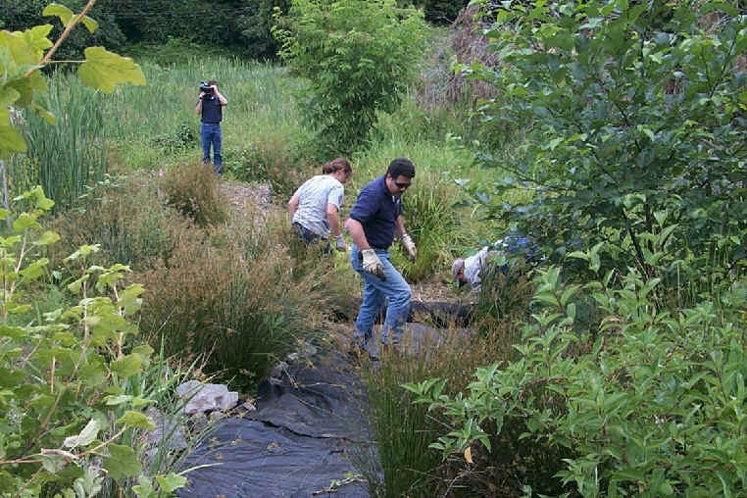
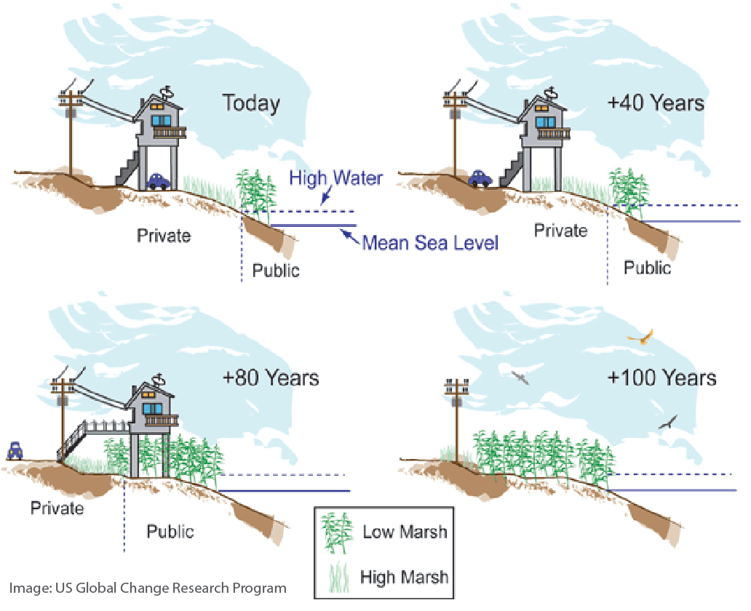
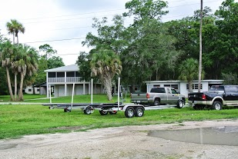
Ecosystem restoration
Gradually relocate inland
Accommodation and compatibility of the built environment

Slide 14
Coastal Change Oral History &
Sea Level Affected Marshes Model (SLAMM)
Videos

Slide 15
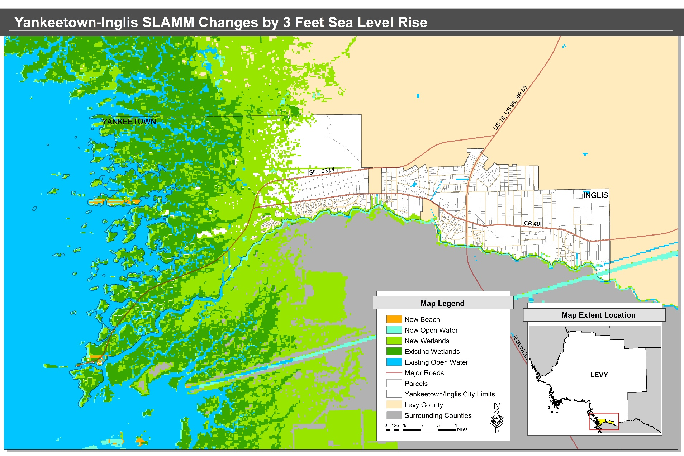
Areas Likely to Change by Year 2100
Data source: The Nature Conservancy
Notes:
To be updated

Slide 16
Raising awareness and concern for coastal change…
The Changing Levy Coast Project seeks to raise awareness on the following topics, it is your choice to incorporate one or more…
  Saltwater intrusion and water supply
  Conservation and ecosystem restoration
  Long-term planning for coastal change while maintaining rural community character
  Incorporating policy change to address sea level rise issues
  Need support and help from the State of Florida

Slide 17
What does this mean for Levy County?
  We need to plan ahead so we can:
    Avoid land use conflicts
    Better prioritize land allocation and future conservation efforts
    Maintain critical ecological corridors and adapt them to future sea level rise
    Make informed decisions on capital investments/improvements

Slide 18
Economic concerns with future changes to the coast
We need to consider how these will be affected by rising seas ➔ wise future investment and decision making
What does SLR mean for:
  Capital investments/improvements
    Roads, real estate, buildings, future development, etc.
  Infrastructure and utilities
  Tourism
  Other industries

Slide 19
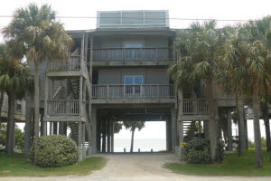
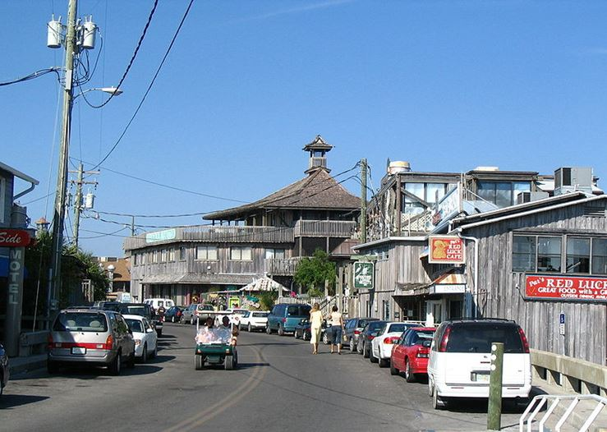
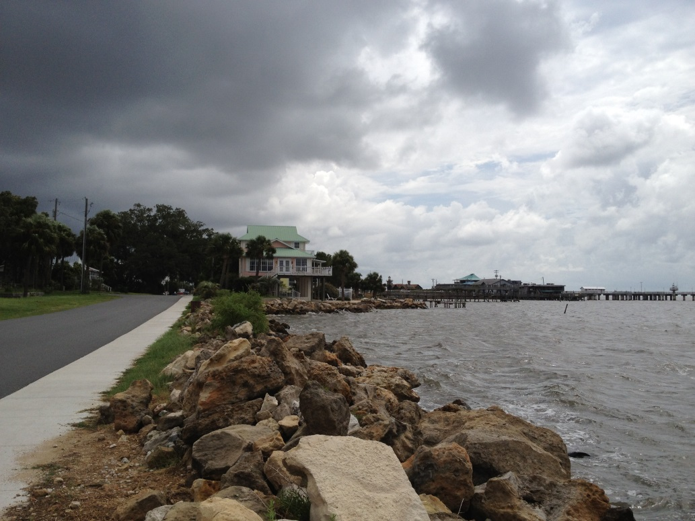
Economic impacts & Considering Spirit of Place

Slide 20
Conservation concerns
Coastlines are in a constant state of give and take
  Sediment deposition builds coastlines
  Coastal erosion takes coastline away, or moves it around (think coastal inlets)
Higher sea levels result in:
  Greater stresses on habitat – more salinity, increased flooding
  Alters the ecosystem ➔ coastal habitats migrate
    Coastline and saltwater marshes move inland, often displacing coastal forests
    Habitat needs space to migrate

Slide 21
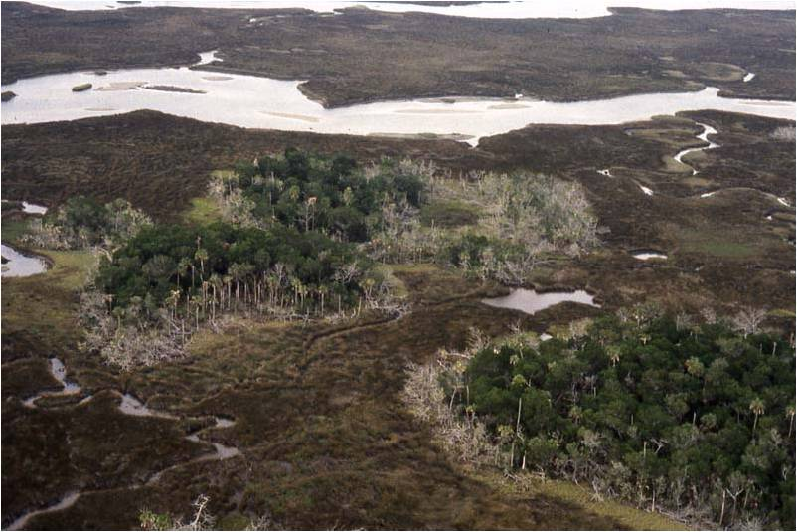
Photo Credit: Jack Putz
Declining coastal hammock in the Withlacoochee Gulf Preserve

Slide 22
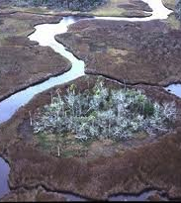
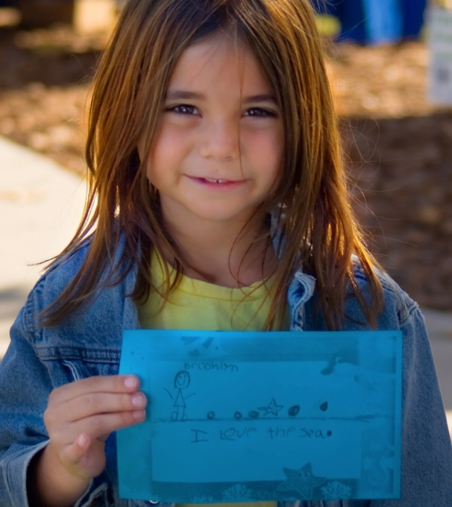
Why Plan Now?
Coastal change is happening now and will accelerate.
Planning is slow, so need to start now.
Responsible and responsive leadership.
Opportunities to reduce costs, explore new markets, and plan better overall.

Slide 23
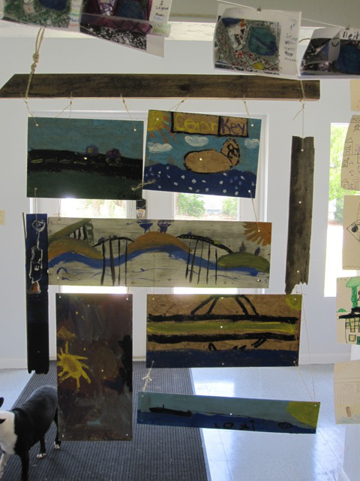
Why Art Now?
Art can express aspects of this multi-faceted subject in a way that is valuable and unique
  Capturing the more intangible aspects, this will complement the research and data available.
What is important to you to express as a community member?

Slide 24
All aboard…
ChangingLevyCoast.org

